Slide 1
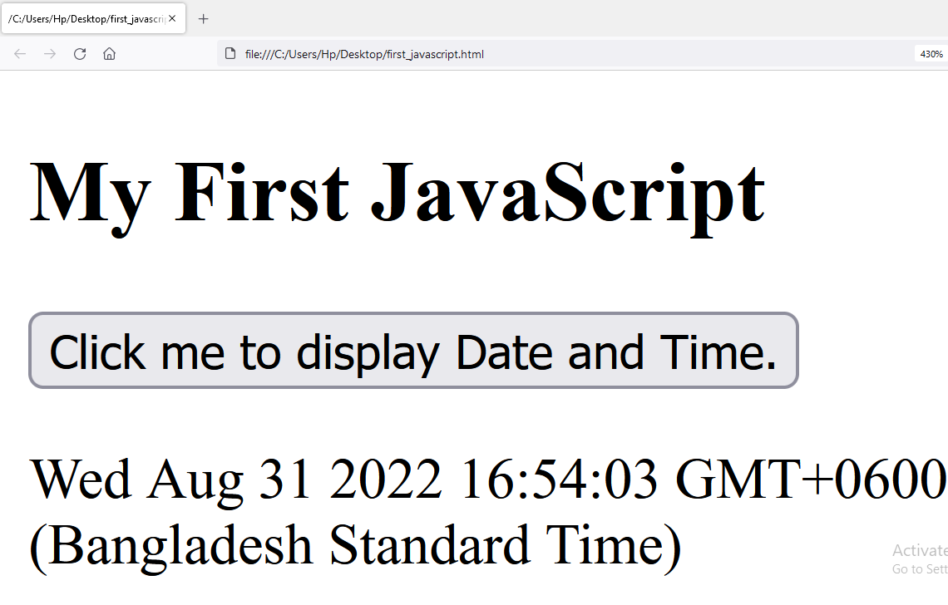
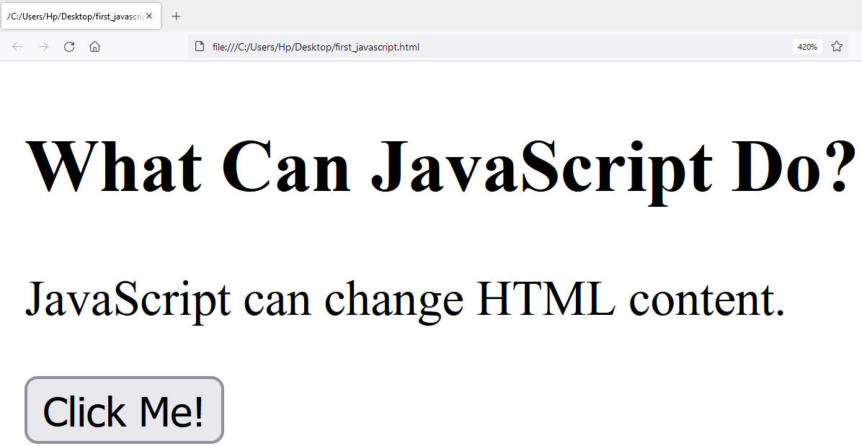
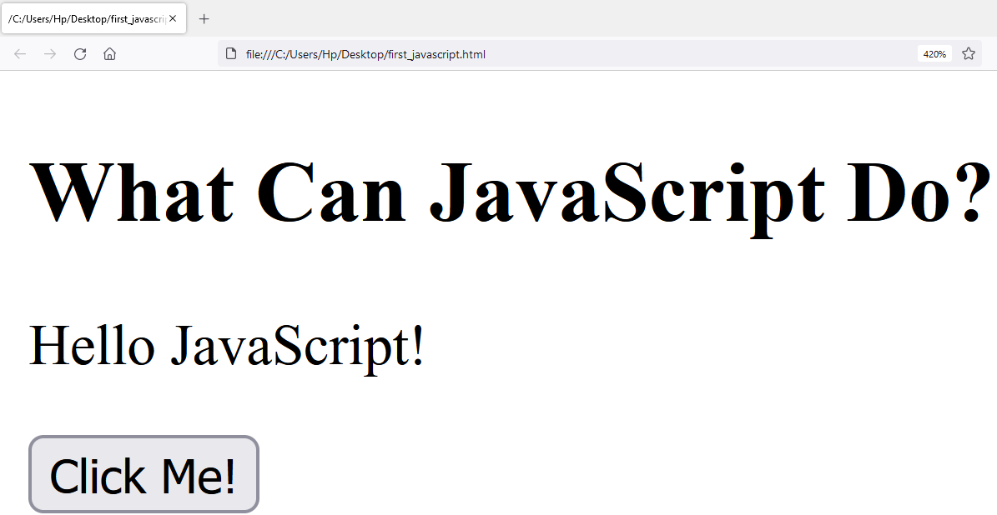
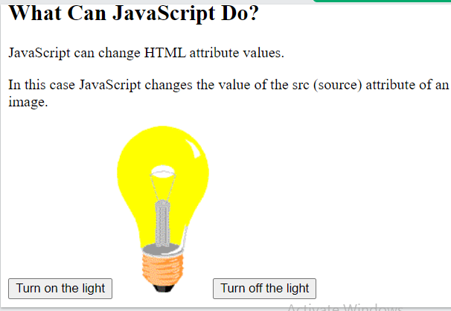
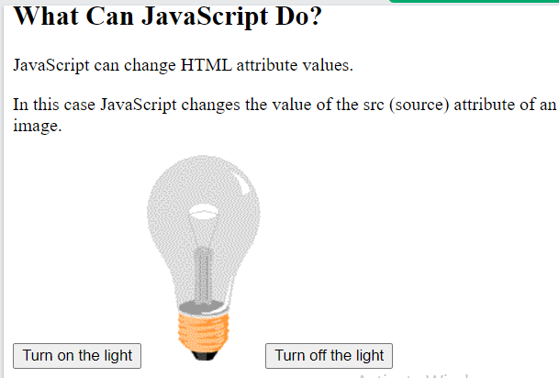
<!DOCTYPE html>
<html>
<body>
<h2>My First JavaScript</h2>
<button type="button"
onclick="document.getElementById('demo').innerHTML = Date()">
Click me to display Date and Time.</button>
<p id="demo"></p>
</body>
</html>
JavaScript Introduction
JavaScript Can Change HTML Content
One of many JavaScript HTML methods is getElementById().
The example below "finds" an HTML element (with id="demo"), and changes the element content (innerHTML) to "Hello JavaScript":
<!DOCTYPE html>
<html>
<body>
<h2>What Can JavaScript Do?</h2>
<p id="demo">JavaScript can change HTML content.</p>
<button type="button" onclick='document.getElementById("demo").innerHTML = "Hello JavaScript!"'>Click Me!</button>
</body>
</html>
JavaScript Can Change HTML Attribute Values
In this example JavaScript changes the value of the src (source) attribute of an <img> tag:
<!DOCTYPE html>
<html>
<body>
<h2>What Can JavaScript Do?</h2>
<p>JavaScript can change HTML attribute values.</p>
<p>In this case JavaScript changes the value of the src (source) attribute of an image.</p>
<button onclick="document.getElementById('myImage').src='pic_bulbon.gif'">Turn on the light</button>
<img id="myImage" src="pic_bulboff.gif" style="width:100px">
<button onclick="document.getElementById('myImage').src='pic_bulboff.gif'">Turn off the light</button>
</body>
</html>

Slide 2
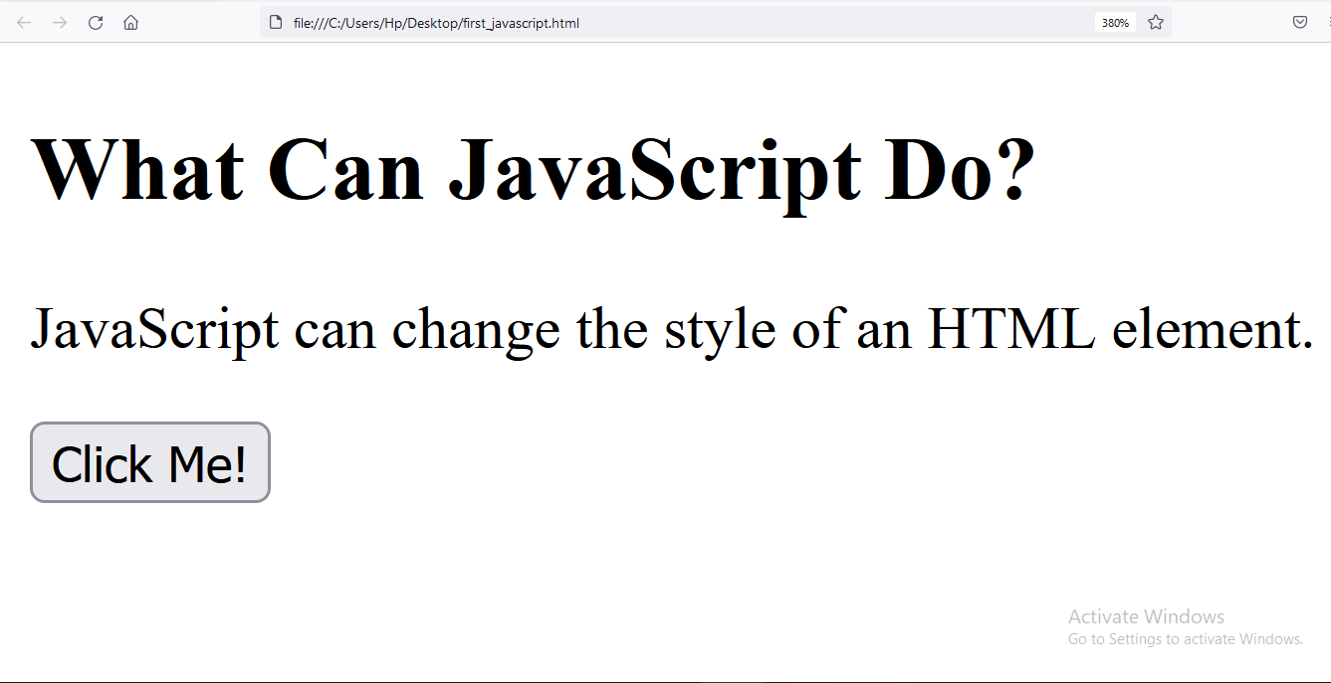
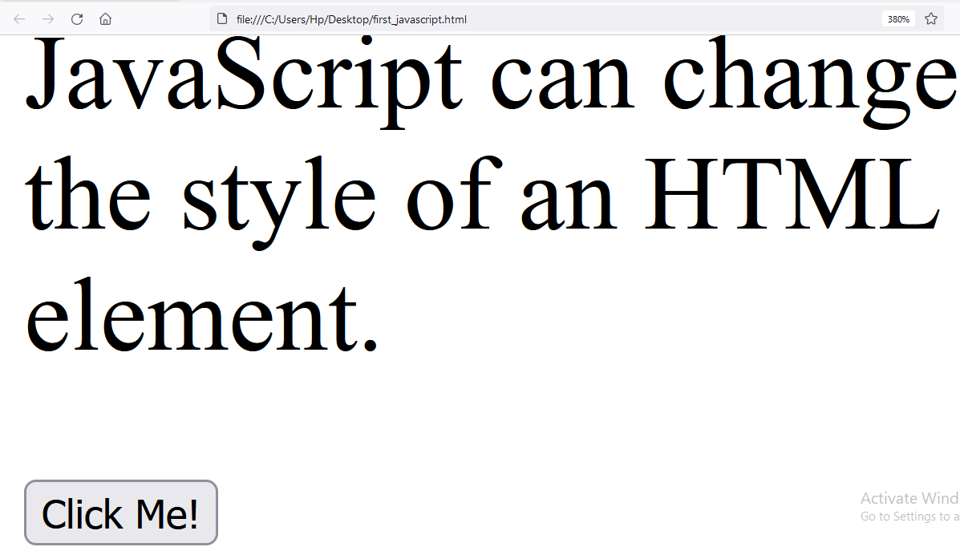
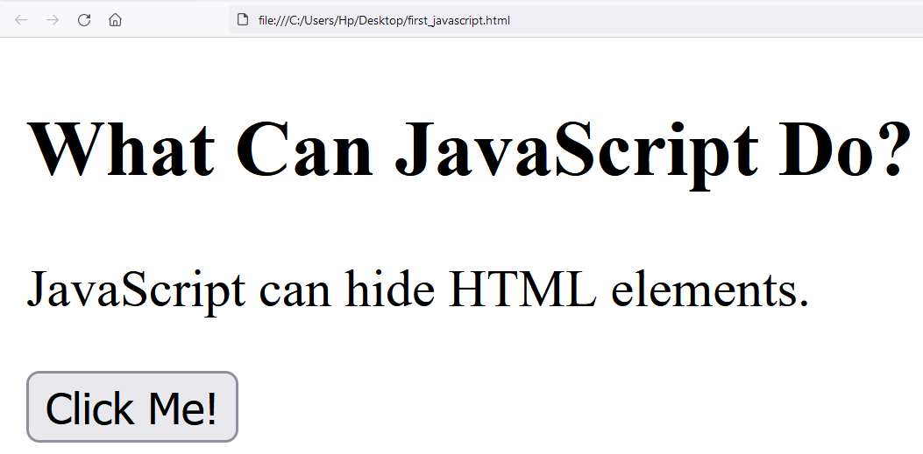
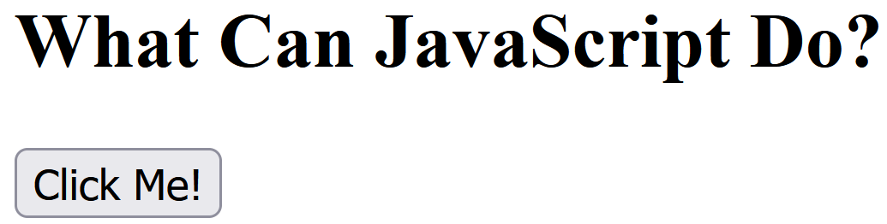
JavaScript Can Change HTML Styles (CSS)
Changing the style of an HTML element, is a variant of changing an HTML attribute:
<!DOCTYPE html>
<html>
<body>
<h2>What Can JavaScript Do?</h2>
<p id="demo">JavaScript can change the style of an HTML element.</p>
<button type="button" onclick="document.getElementById('demo').style.fontSize='35px'">Click Me!</button>
</body>
</html>
JavaScript Can Hide HTML Elements
Hiding HTML elements can be done by changing the display style:
<!DOCTYPE html>
<html>
<body>
<h2>What Can JavaScript Do?</h2>
<p id="demo">JavaScript can hide HTML elements.</p>
<button type="button" onclick="document.getElementById('demo').style.display='none'">Click Me!</button>
</body>
</html>
JavaScript Can Show HTML Elements
Showing hidden HTML elements can also be done by changing the display style:
<h2>What Can JavaScript Do?</h2>
<p>JavaScript can show hidden HTML elements.</p>
<p id="demo" style="display:none">Hello JavaScript!</p>
<button type="button" onclick="document.getElementById('demo').style.display='block'">Click Me!</button>

Slide 3
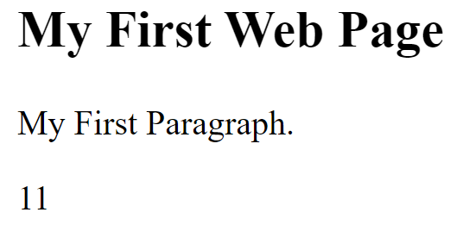
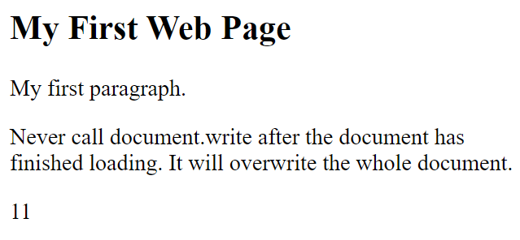
JavaScript Output
JavaScript Display Possibilities
JavaScript can "display" data in different ways:
Writing into an HTML element, using innerHTML.
Writing into the HTML output using document.write().
Writing into an alert box, using window.alert().
Writing into the browser console, using console.log()
Using innerHTML
To access an HTML element, JavaScript can use the document.getElementById(id) method.
The id attribute defines the HTML element. The innerHTML property defines the HTML content
<!DOCTYPE html>
<html>
<body>
<h2>My First Web Page</h2>
<p>My First Paragraph.</p>
<p id="demo"></p>
<script>
document.getElementById("demo").innerHTML = 5 + 6;
</script>
</body>
</html>
Changing the innerHTML property of an HTML element is a common way to display data in HTML.
Using document.write()
For testing purposes, it is convenient to use document.write():
<!DOCTYPE html>
<html>
<body>
<h2>My First Web Page</h2>
<p>My first paragraph.</p>
<p>Never call document.write after the document has finished loading.
It will overwrite the whole document.</p>
<script>
document.write(5 + 6);
</script>
</body>
</html>
Using document.write() after an HTML document is loaded, will delete all existing HTML:

Slide 4
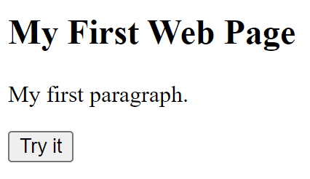
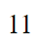
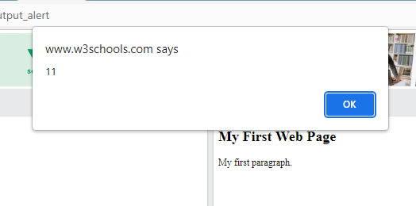
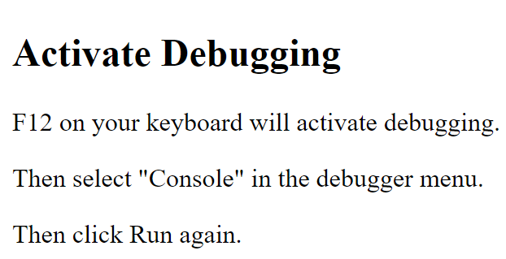
<!DOCTYPE html>
<html>
<body>
<h2>My First Web Page</h2>
<p>My first paragraph.</p>
<button type="button" onclick="document.write(5 + 6)">Try it</button>
</body>
</html>
The document.write() method should only be used for testing.
Using window.alert()
You can use an alert box to display data
<!DOCTYPE html>
<html>
<body>
<h2>My First Web Page</h2>
<p>My first paragraph.</p>
<script>
window.alert(5 + 6);
</script>
</body>
</html>
You can skip the window keyword.
In JavaScript, the window object is the global scope object, that means that variables, properties, and methods by default belong to the window object. This also means that specifying the window keyword is optional:
Using console.log()
For debugging purposes, you can call the console.log() method in the browser to display data.
You will learn more about debugging in a later chapter.
<!DOCTYPE html>
<html>
<body>
<h2>Activate Debugging</h2>
<p>F12 on your keyboard will activate debugging.</p>
<p>Then select "Console" in the debugger menu.</p>
<p>Then click Run again.</p>
<script>
console.log(5 + 6);
</script>
</body>
</html>

Slide 5
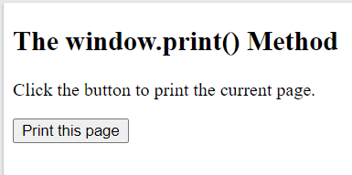
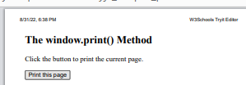
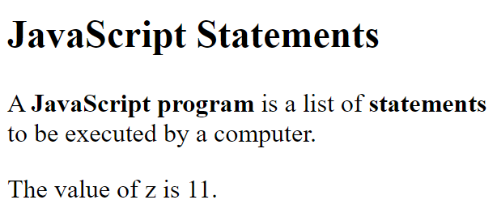
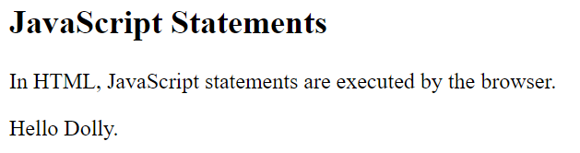
JavaScript Print
<!DOCTYPE html>
<html>
<body>
<h2>The window.print() Method</h2>
<p>Click the button to print the current page.</p>
<button onclick="window.print()">Print this page</button>
</body>
</html>
JavaScript Statements
JavaScript Programs
A computer program is a list of "instructions" to be "executed" by a computer.
In a programming language, these programming instructions are called statements.
A JavaScript program is a list of programming statements.
<!DOCTYPE html>
<html>
<body>
<h2>JavaScript Statements</h2>
<p>A <b>JavaScript program</b> is a list of <b>statements</b> to be executed by a computer.</p>
<p id="demo"></p>
<script>
let x, y, z; // Statement 1
x = 5; // Statement 2
y = 6; // Statement 3
z = x + y; // Statement 4
document.getElementById("demo").innerHTML =
"The value of z is " + z + ".";
</script>
</body>
</html>
In HTML, JavaScript programs are executed by the web browser.
JavaScript Statements
JavaScript statements are composed of: Values, Operators, Expressions, Keywords, and Comments.
This statement tells the browser to write "Hello Dolly." inside an HTML element with id="demo":
<!DOCTYPE html>
<html><body>
<h2>JavaScript Statements</h2>
<p>In HTML, JavaScript statements are executed by the browser.</p>
<p id="demo"></p>
<script>
document.getElementById("demo").innerHTML = "Hello Dolly.";
</script>
</body></html>

Slide 6
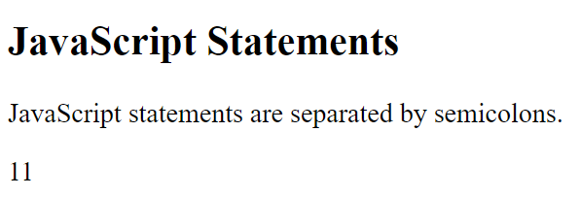
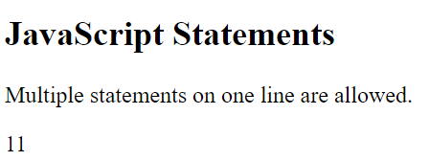
Most JavaScript programs contain many JavaScript statements.
The statements are executed, one by one, in the same order as they are written.
JavaScript programs (and JavaScript statements) are often called JavaScript code.
Semicolons ;
Semicolons separate JavaScript statements.
Add a semicolon at the end of each executable statement:
<!DOCTYPE html>
<html>
<body>
<h2>JavaScript Statements</h2>
<p>JavaScript statements are separated by semicolons.</p>
<p id="demo1"></p>
<script>
let a, b, c;
a = 5;
b = 6;
c = a + b;
document.getElementById("demo1").innerHTML = c;
</script>
</body>
</html>
When separated by semicolons, multiple
statements on one line are allowed:
<!DOCTYPE html>
<html><body>
<h2>JavaScript Statements</h2>
<p>Multiple statements on one line are allowed.</p>
<p id="demo1"></p>
<script>
let a, b, c;
a = 5; b = 6; c = a + b;
document.getElementById("demo1").innerHTML = c;
</script>
</body>
</html>
On the web, you might see examples without semicolons. Ending statements with semicolon is not required, but highly recommended.

Slide 7
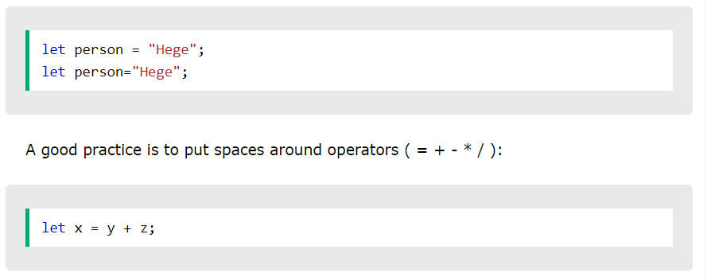
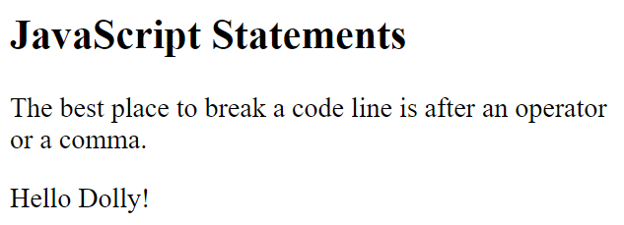
JavaScript White Space
JavaScript ignores multiple spaces. You can add white space to your script to make it more readable.
The following lines are equivalent:
JavaScript Line Length and Line Breaks
For best readability, programmers often like to avoid code lines longer than 80 characters.
If a JavaScript statement does not fit on one line, the best place to break it is after an operator:
<!DOCTYPE html>
<html>
<body>
<h2>JavaScript Statements</h2>
<p>
The best place to break a code line is after an operator or a comma.
</p>
<p id="demo"></p>
<script>
document.getElementById("demo").innerHTML =
"Hello Dolly!";
</script>
</body>
</html>

Slide 8
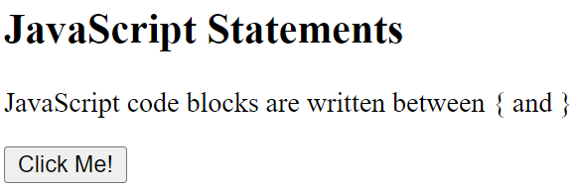
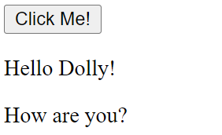
JavaScript Code Blocks
JavaScript statements can be grouped together in code blocks, inside curly brackets {...}.
The purpose of code blocks is to define statements to be executed together.
One place you will find statements grouped together in blocks, is in JavaScript functions:
<!DOCTYPE html>
<html>
<body>
<h2>JavaScript Statements</h2>
<p>JavaScript code blocks are written between { and }</p>
<button type="button" onclick="myFunction()">Click Me!</button>
<p id="demo1"></p>
<p id="demo2"></p>
<script>
function myFunction() {
document.getElementById("demo1").innerHTML = "Hello Dolly!";
document.getElementById("demo2").innerHTML = "How are you?";
}
</script>
</body>
</html>
In this tutorial we use 2 spaces of indentation for code blocks. You will learn more about functions later in this tutorial.
JavaScript Keywords
JavaScript statements often start with a keyword to identify the JavaScript action to be performed.
Our Reserved Words Reference lists all JavaScript keywords.
Here is a list of some of the keywords you will learn about in this tutorial:
Keyword | Description
var | Declares a variable
let | Declares a block variable
const | Declares a block constant
if | Marks a block of statements to be executed on a condition
switch | Marks a block of statements to be executed in different cases
for | Marks a block of statements to be executed in a loop
function | Declares a function
return | Exits a function
try | Implements error handling to a block of statements
JavaScript keywords are reserved words. Reserved words cannot be used as names for variables.

Slide 9
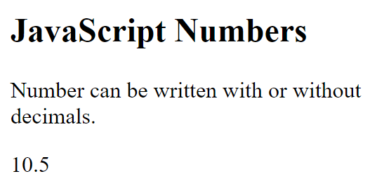
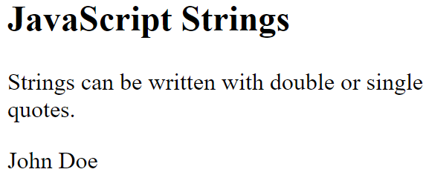
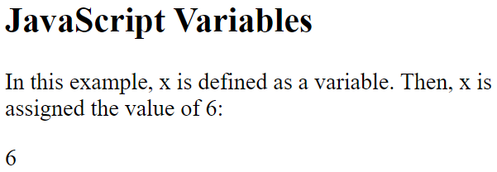
06. JavaScript Syntax
JavaScript syntax is the set of rules, how JavaScript programs are constructed:
// How to create variables: var x; let y; // How to use variables: x = 5; y = 6; let z = x + y;
JavaScript Values
The JavaScript syntax defines two types of values:
Fixed values
Variable values
Fixed values are called Literals.
Variable values are called Variables.
JavaScript Literals
The two most important syntax rules for fixed values are:
1. Numbers are written with or without decimals:
<!DOCTYPE html>
<html><body>
<h2>JavaScript Numbers</h2>
<p>Number can be written with or without decimals.</p>
<p id="demo"></p>
<script>
document.getElementById("demo").innerHTML = 10.50;
</script>
</body></html>
2. Strings are text, written within double or single quotes:
<!DOCTYPE html>
<html><body>
<h2>JavaScript Strings</h2>
<p>Strings can be written with double or single quotes.</p>
<p id="demo"></p>
<script>
document.getElementById("demo").innerHTML = 'John Doe';
</script>
</body></html>
JavaScript Variables
In a programming language, variables are used to store data values.
JavaScript uses the keywords var, let and const to declare variables.
An equal sign is used to assign values to variables.
In this example, x is defined as a variable. Then, x is assigned (given) the value 6:
<!DOCTYPE html>
<html><body>
<h2>JavaScript Variables</h2>
<p>In this example, x is defined as a variable.
Then, x is assigned the value of 6:</p>
<p id="demo"></p>
<script>
let x;
x = 6;
document.getElementById("demo").innerHTML = x;
</script>
</body></html>

Slide 10
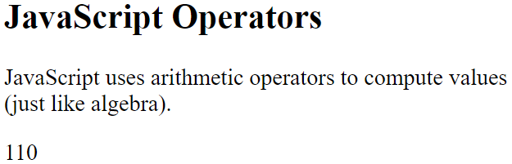
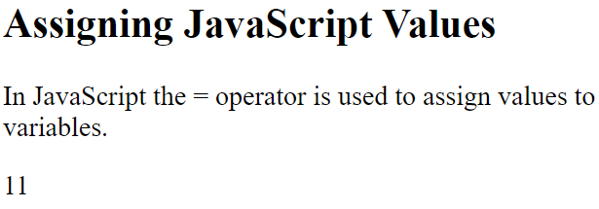
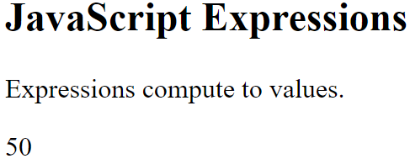
JavaScript Operators
JavaScript uses arithmetic operators ( + - * / ) to compute values:
<!DOCTYPE html>
<html>
<body>
<h2>JavaScript Operators</h2>
<p>JavaScript uses arithmetic operators to compute values (just like algebra).</p>
<p id="demo"></p>
<script>
document.getElementById("demo").innerHTML = (5 + 6) * 10;
</script>
</body>
</html>
JavaScript uses an assignment operator ( = ) to assign values to variables:
<!DOCTYPE html>
<html>
<body>
<h2>Assigning JavaScript Values</h2>
<p>In JavaScript the = operator is used to assign values to variables.</p>
<p id="demo"></p>
<script>
let x, y;
x = 5;
y = 6;
document.getElementById("demo").innerHTML = x + y;
</script>
</body>
</html>
JavaScript Expressions
An expression is a combination of values, variables, and operators, which computes to a value.
The computation is called an evaluation.
For example, 5 * 10 evaluates to 50:
<!DOCTYPE html>
<html><body>
<h2>JavaScript Expressions</h2>
<p>Expressions compute to values.</p>
<p id="demo"></p>
<script>
document.getElementById("demo").innerHTML = 5 * 10;
</script>
</body>
</html>

Slide 11
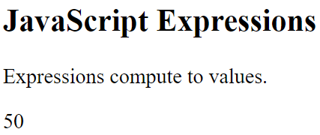
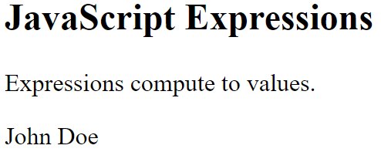
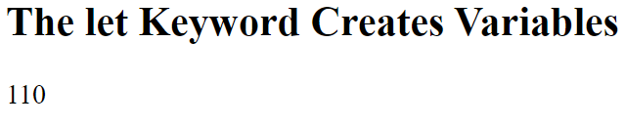
Expressions can also contain variable values:
<!DOCTYPE html>
<html>
<body>
<h2>JavaScript Expressions</h2>
<p>Expressions compute to values.</p>
<p id="demo"></p>
<script>
var x;
x = 5;
document.getElementById("demo").innerHTML = x * 10;
</script>
</body>
</html>
The values can be of various types, such as numbers and strings.
For example, "John" + " " + "Doe", evaluates to "John Doe":
<!DOCTYPE html>
<html>
<body>
<h2>JavaScript Expressions</h2>
<p>Expressions compute to values.</p>
<p id="demo"></p>
<script>
document.getElementById("demo").innerHTML = "John" + " " + "Doe";
</script>
</body>
</html>
JavaScript Keywords
JavaScript keywords are used to identify actions to be performed.
The let keyword tells the browser to create variables:
<!DOCTYPE html>
<html>
<body>
<h2>The <b>let</b> Keyword Creates Variables</h2>
<p id="demo"></p>
<script>
let x, y;
x = 5 + 6;
y = x * 10;
document.getElementById("demo").innerHTML = y;
</script>
</body>
</html>

Slide 12
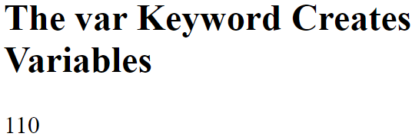
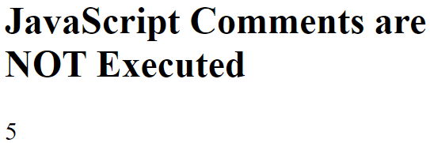
The var keyword also tells the browser to create variables:
<!DOCTYPE html>
<html>
<body>
<h2>The var Keyword Creates Variables</h2>
<p id="demo"></p>
<script>
var x, y;
x = 5 + 6;
y = x * 10;
document.getElementById("demo").innerHTML = y;
</script>
</body>
</html>
In these examples, using var or let will produce the same result.
You will learn more about var and let later in this tutorial.
JavaScript Comments
Not all JavaScript statements are "executed".
Code after double slashes // or between /* and */ is treated as a comment.
Comments are ignored, and will not be executed:
<!DOCTYPE html>
<html>
<body>
<h2>JavaScript Comments are NOT Executed</h2>
<p id="demo"></p>
<script>
let x;
x = 5;
// x = 6; I will not be executed
document.getElementById("demo").innerHTML = x;
</script>
</body>
</html>
You will learn more about comments in a later chapter.
JavaScript Identifiers / Names
Identifiers are JavaScript names.
Identifiers are used to name variables and keywords, and functions.
The rules for legal names are the same in most programming languages.
A JavaScript name must begin with:
A letter (A-Z or a-z)
A dollar sign ($)
Or an underscore (_)
Subsequent characters may be letters, digits, underscores, or dollar signs.
Note
Numbers are not allowed as the first character in names.
This way JavaScript can easily distinguish identifiers from numbers.

Slide 13
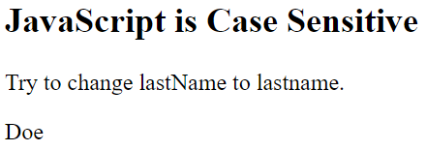
JavaScript is Case Sensitive
All JavaScript identifiers are case sensitive.
The variables lastName and lastname, are two different variables:
<!DOCTYPE html>
<html>
<body>
<h2>JavaScript is Case Sensitive</h2>
<p>Try to change lastName to lastname.</p>
<p id="demo"></p>
<script>
let lastname, lastName;
lastName = "Doe";
lastname = "Peterson";
document.getElementById("demo").innerHTML = lastName;
</script>
</body>
</html>
JavaScript does not interpret LET or Let as the keyword let.
JavaScript and Camel Case
Historically, programmers have used different ways of joining multiple words into one variable name:
Hyphens:
first-name, last-name, master-card, inter-city.
Hyphens are not allowed in JavaScript. They are reserved for subtractions.
Underscore:
first_name, last_name, master_card, inter_city.
Upper Camel Case (Pascal Case):
FirstName, LastName, MasterCard, InterCity.
Lower Camel Case:
JavaScript programmers tend to use camel case that starts with a lowercase letter:
firstName, lastName, masterCard, interCity.
JavaScript Character Set
JavaScript uses the Unicode character set.
Unicode covers (almost) all the characters, punctuations, and symbols in the world.
For a closer look, please study our Complete Unicode Reference.

Slide 14
07) JavaScript Comments
Single Line Comments
Single line comments start with //.
Any text between // and the end of the line will be ignored by JavaScript (will not be executed).
This example uses a single-line comment before each code line:
JavaScript comments can be used to explain JavaScript code, and to make it more readable.
JavaScript comments can also be used to prevent execution, when testing alternative code.
Example
Using Comments to Prevent Execution
Using comments to prevent execution of code is suitable for code testing.
Adding // in front of a code line changes the code lines from an executable line to a comment.
This example uses // to prevent execution of one of the code lines:

Slide 15
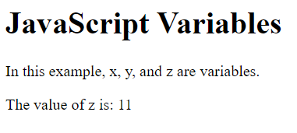
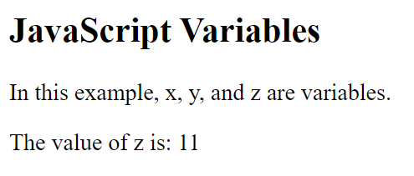
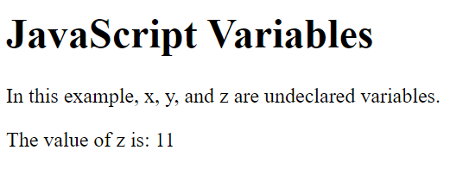
8)JavaScript Variables
4 Ways to Declare a JavaScript Variable:
Using var
Using let
Using const
Using nothing
What are Variables?
Variables are containers for storing data (storing data values).
In this example, x, y, and z, are variables, declared with the var keyword:
<h1>JavaScript Variables</h1>
<p>In this example, x, y, and z are variables.</p>
<p id="demo"></p>
<script>
var x = 5;
var y = 6;
var z = x + y;
document.getElementById("demo").innerHTML =
"The value of z is: " + z;
</script>
In this example, x, y, and z, are variables, declared with the let keyword:
<h2>JavaScript Variables</h2>
<p>In this example, x, y, and z are variables.</p>
<p id="demo"></p>
<script>
let x = 5;
let y = 6;
let z = x + y;
document.getElementById("demo").innerHTML =
"The value of z is: " + z;
</script>
In this example, x, y, and z, are undeclared variables:
<h1>JavaScript Variables</h1>
<p>In this example, x, y, and z are undeclared variables.</p>
<p id="demo"></p>
<script>
x = 5;
y = 6;
z = x + y;
document.getElementById("demo").innerHTML =
"The value of z is: " + z;
</script>
From all the examples above, you can guess:
x stores the value 5
y stores the value 6
z stores the value 11

Slide 16
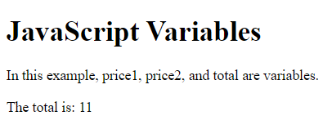
When to Use JavaScript var?
Always declare JavaScript variables with var,let, orconst.
The var keyword is used in all JavaScript code from 1995 to 2015.
The let and const keywords were added to JavaScript in 2015.
If you want your code to run in older browsers, you must use var.
When to Use JavaScript const?
If you want a general rule: always declare variables with const.
If you think the value of the variable can change, use let.
In this example, price1, price2, and total, are variables:
<!DOCTYPE html>
<html>
<body>
<h1>JavaScript Variables</h1>
<p>In this example, price1, price2, and total are variables.</p>
<p id="demo"></p>
<script>
const price1 = 5;
const price2 = 6;
let total = price1 + price2;
document.getElementById("demo").innerHTML =
"The total is: " + total;
</script>
</body>
</html>
The two variables price1 and price2 are declared with the const keyword.
These are constant values and cannot be changed.
The variable total is declared with the let keyword.
This is a value that can be changed.
Just Like Algebra
Just like in algebra, variables hold values:
let x = 5; let y = 6;
Just like in algebra, variables are used in expressions:
let z = x + y;
From the example above, you can guess that the total is calculated to be 11.
Note
Variables are containers for storing values.
JavaScript Identifiers
All JavaScript variables must be identified with unique names.
These unique names are called identifiers.
Identifiers can be short names (like x and y) or more descriptive names (age, sum, totalVolume).
The general rules for constructing names for variables (unique identifiers) are:
Names can contain letters, digits, underscores, and dollar signs.
Names must begin with a letter.
Names can also begin with $ and _ (but we will not use it in this tutorial).
Names are case sensitive (y and Y are different variables).
Reserved words (like JavaScript keywords) cannot be used as names.

Slide 17
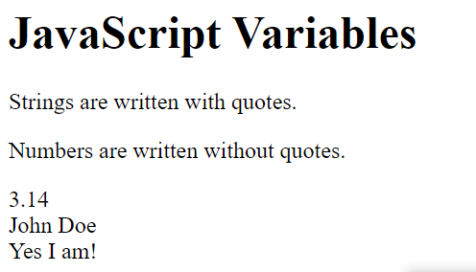
Note
JavaScript identifiers are case-sensitive.
The Assignment Operator
In JavaScript, the equal sign (=) is an "assignment" operator, not an "equal to" operator.
This is different from algebra. The following does not make sense in algebra:
x = x + 5
In JavaScript, however, it makes perfect sense: it assigns the value of x + 5 to x.
(It calculates the value of x + 5 and puts the result into x. The value of x is incremented by 5.)
Note
The "equal to" operator is written like == in JavaScript
JavaScript Data Types
JavaScript variables can hold numbers like 100 and text values like "John Doe".
In programming, text values are called text strings.
JavaScript can handle many types of data, but for now, just think of numbers and strings.
Strings are written inside double or single quotes. Numbers are written without quotes.
If you put a number in quotes, it will be treated as a text string.
Eample
<h1>JavaScript Variables</h1>
<p>Strings are written with quotes.</p>
<p>Numbers are written without quotes.</p>
<p id="demo"></p>
<script> let carName; let carName;
const pi = 3.14;
let person = "John Doe";
let answer = 'Yes I am!';
document.getElementById("demo").innerHTML =
pi + "<br>" + person + "<br>" + answer;
</script>
Declaring a JavaScript Variable
Creating a variable in JavaScript is called "declaring" a variable.
You declare a JavaScript variable with the var or the let keyword:
var carName;
or
let carName;
After the declaration, the variable has no value (technically it is undefined).
To assign a value to the variable, use the equal sign:
carName = "Volvo";
You can also assign a value to the variable when you declare it:
let carName = "Volvo";

Slide 18
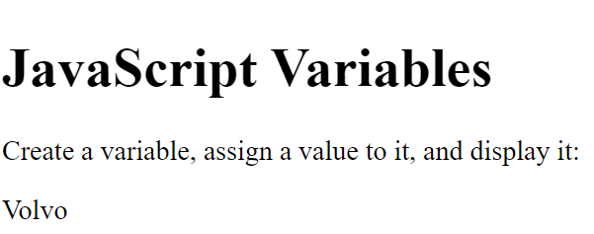
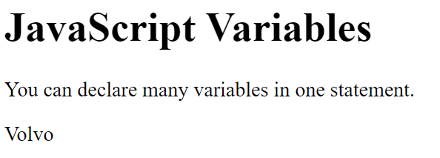
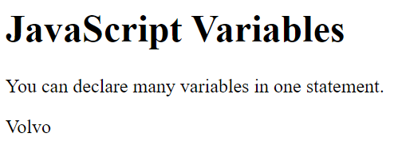
<!DOCTYPE html>
<html>
<body>
<h1>JavaScript Variables</h1>
<p>Create a variable, assign a value to it, and display it:</p>
<p id="demo"></p>
<script>
let carName = "Volvo";
document.getElementById("demo").innerHTML = carName;
</script>
</body>
</html>
Note
It's a good programming practice to declare all variables at the beginning of a script.
One Statement, Many Variables
You can declare many variables in one statement.
Start the statement with let and separate the variables by comma:
<!DOCTYPE html><html><body>
<h1>JavaScript Variables</h1>
<p>You can declare many variables in one statement.</p>
<p id="demo"></p>
<script>
let person = "John Doe", carName = "Volvo", price = 200;
document.getElementById("demo").innerHTML = carName;
</script>
</body></html>
A declaration can span multiple lines:
<!DOCTYPE html>
<html>
<body>
<h1>JavaScript Variables</h1>
<p>You can declare many variables in one statement.</p>
<p id="demo"></p>
<script>
let person = "John Doe",
carName = "Volvo",
price = 200;
document.getElementById("demo").innerHTML = carName;
</script>
</body>
</html>

Slide 19
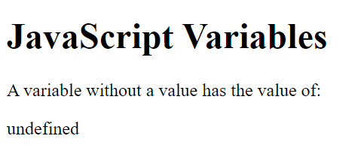
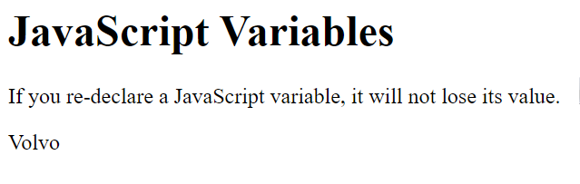
Value = undefined
In computer programs, variables are often declared without a value. The value can be something that has to be calculated, or something that will be provided later, like user input.
A variable declared without a value will have the value undefined.
The variable carName will have the value undefined after the execution of this statement:
Example
<!DOCTYPE html>
<html>
<body>
<h1>JavaScript Variables</h1>
<p>A variable without a value has the value of:</p>
<p id="demo"></p>
<script>
let carName;
document.getElementById("demo").innerHTML = carName;
</script>
</body>
</html>
Re-Declaring JavaScript Variables
If you re-declare a JavaScript variable declared with var, it will not lose its value.
The variable carName will still have the value "Volvo" after the execution of these statements:
Example
<!DOCTYPE html>
<html>
<body>
<h1>JavaScript Variables</h1>
<p>If you re-declare a JavaScript variable, it will not lose its value.</p>
<p id="demo"></p>
<script>
var carName = "Volvo";
var carName;
document.getElementById("demo").innerHTML = carName;
</script>
</body>
</html>
Note
You cannot re-declare a variable declared with let or const.
This will not work:
let carName = "Volvo"; let carName;

Slide 20
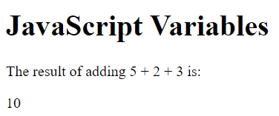
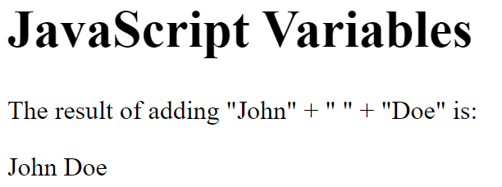
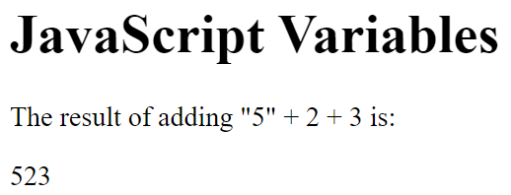
JavaScript Arithmetic
As with algebra, you can do arithmetic with JavaScript variables, using operators like = and +:
Example
<!DOCTYPE html>
<html>
<body>
<h1>JavaScript Variables</h1>
<p>The result of adding 5 + 2 + 3 is:</p>
<p id="demo"></p>
<script>
let x = 5 + 2 + 3;
document.getElementById("demo").innerHTML = x;
</script>
</body>
</html>
You can also add strings, but strings will be concatenated:
<!DOCTYPE html>
<html>
<body>
<h1>JavaScript Variables</h1>
<p>The result of adding "John" + " " + "Doe" is:</p>
<p id="demo"></p>
<script>
let x = "John" + " " + "Doe";
document.getElementById("demo").innerHTML = x;
</script>
</body>
</html>
Also try this:
<!DOCTYPE html>
<html>
<body>
<h1>JavaScript Variables</h1>
<p>The result of adding "5" + 2 + 3 is:</p>
<p id="demo"></p>
<script>
let x = "5" + 2 + 3;
document.getElementById("demo").innerHTML = x;
</script>
</body>
</html>

Slide 21



Note
If you put a number in quotes, the rest of the numbers will be treated as strings, and concatenated.
Now try this:
<!DOCTYPE html><html><body>
<h1>JavaScript Variables</h1>
<p>The result of adding 2 + 3 + "5" is:</p>
<p id="demo"></p>
<script>
let x = 2 + 3 + "5";
document.getElementById("demo").innerHTML = x;
</script>
</body></html>
JavaScript Dollar Sign $
Since JavaScript treats a dollar sign as a letter, identifiers containing $ are valid variable names:
<!DOCTYPE html><html><body>
<h1>JavaScript Variables</h1>
<p>The dollar sign is treated as a letter in JavaScript names.</p>
<p id="demo"></p>
<script>
let $$$ = 2;
let $myMoney = 5;
document.getElementById("demo").innerHTML = $$$ + $myMoney;
</script></body></html>
Using the dollar sign is not very common in JavaScript, but professional programmers often use it as an alias for the main function in a JavaScript library.
In the JavaScript library jQuery, for instance, the main function $ is used to select HTML elements. In jQuery $("p"); means "select all p elements".
JavaScript Underscore (_)
Since JavaScript treats underscore as a letter, identifiers containing _ are valid variable names:
<!DOCTYPE html>
<html>
<body>
<h1>JavaScript Variables</h1>
<p>The underscore is treated as a letter in JavaScript names.</p>
<p id="demo"></p>
<script>
let _x = 2;
let _100 = 5;
document.getElementById("demo").innerHTML = _x + _100;
</script>
</body>
</html>

Slide 22
9)JavaScript Let
The let keyword was introduced in ES6 (2015).
Variables defined with let cannot be Redeclared.
Variables defined with let must be Declared before use.
Variables defined with let have Block Scope.
Cannot be Redeclared
Variables defined with let cannot be redeclared.
You cannot accidentally redeclare a variable.
With let you can not do this:
Example
let x = "John Doe"; let x = 0; // SyntaxError: 'x' has already been declared
With var you can:
Example
var x = "John Doe"; var x = 0;
Block Scope
Before ES6 (2015), JavaScript had only Global Scope and Function Scope.
ES6 introduced two important new JavaScript keywords: let and const.
These two keywords provide Block Scope in JavaScript.
Variables declared inside a { } block cannot be accessed from outside the block:
Example
{ let x = 2; } // x can NOT be used here
Variables declared with the var keyword can NOT have block scope.
Variables declared inside a { } block can be accessed from outside the block.
Example
{ var x = 2; } // x CAN be used here
Redeclaring Variables
Redeclaring a variable using the var keyword can impose problems.
Redeclaring a variable inside a block will also redeclare the variable outside the block:

Slide 23


With let, redeclaring a variable in the same block is NOT allowed:
Redeclaring a variable with let, in another block, IS allowed:
<!DOCTYPE html>
<html>
<body>
<h2>JavaScript let</h2>
<p>Redeclaring a JavaScript variable with <b>var</b> is allowed anywhere in a program:</p>
<p id="demo"></p>
<script>
var x = 2;
// Now x is 2
var x = 3;
// Now x is 3
document.getElementById("demo").innerHTML = x;
</script>
</body>
</html>
With let, redeclaring a variable in the same block is NOT allowed:
var x = 2; // Allowed let x = 3; // Not allowed { let x = 2; // Allowed let x = 3; // Not allowed } { let x = 2; // Allowed var x = 3; // Not allowed }
With let, redeclaring a variable in the same block is NOT allowed:
<!DOCTYPE html>
<html>
<body>
<h2>JavaScript let</h2>
<p>Redeclaring a variable with <b>let</b>, in another scope, or in another block, is allowed:</p>
<p id="demo"></p>
<script>
let x = 2; // Allowed
{
let x = 3; // Allowed
}
{
let x = 4; // Allowed
}
document.getElementById("demo").innerHTML = x;
</script>
</body>
</html>

Slide 24


Let Hoisting
Variables defined with var are hoisted to the top and can be initialized at any time.
Meaning: You can use the variable before it is declared:
This is OK:
<!DOCTYPE html>
<html>
<body>
<h2>JavaScript Hoisting</h2>
<p>With <b>var</b>, you can use a variable before it is declared:</p>
<p id="demo"></p>
<script>
carName = "Volvo";
document.getElementById("demo").innerHTML = carName;
var carName;
</script>
</body>
</html>
If you want to learn more about hoisting, study the chapter JavaScript Hoisting.
Variables defined with let are also hoisted to the top of the block, but not initialized.
Meaning: Using a let variable before it is declared will result in a ReferenceError:
<!DOCTYPE html>
<html>
<body>
<h2>JavaScript Hoisting</h2>
<p>With <b>let</b>, you cannot use a variable before it is declared.</p>
<p id="demo"></p>
<script>
try {
carName = "Saab";
let carName = "Volvo";
}
catch(err) {
document.getElementById("demo").innerHTML = err;
}
</script>
</body>
</html>

Slide 25

10)JavaScript Const
The const keyword was introduced in ES6 (2015).
Variables defined with const cannot be Redeclared.
Variables defined with const cannot be Reassigned.
Variables defined with const have Block Scope.
Cannot be Reassigned
A const variable cannot be reassigned:
<!DOCTYPE html><html><body>
<h2>JavaScript const</h2>
<p id="demo"></p>
<script>
try {
const PI = 3.141592653589793;
PI = 3.14;
}
catch (err) {
document.getElementById("demo").innerHTML = err;
}
</script></body></html>
Must be Assigned
JavaScript const variables must be assigned a value when they are declared:
Correct
const PI = 3.14159265359;
Incorrect
const PI; PI = 3.14159265359;
When to use JavaScript const?
Always declare a variable with const when you know that the value should not be changed.
Use const when you declare:
A new Array
A new Object
A new Function
A new RegExp
Constant Objects and Arrays
The keyword const is a little misleading.
It does not define a constant value. It defines a constant reference to a value.
Because of this you can NOT:
Reassign a constant value
Reassign a constant array
Reassign a constant object
But you CAN:
Change the elements of constant array
Change the properties of constant object

Slide 26


Constant Arrays
You can change the elements of a constant array:
<!DOCTYPE html>
<html>
<body>
<h2>JavaScript const</h2>
<p>Declaring a constant array does NOT make the elements unchangeable:</p>
<p id="demo"></p>
<script>
// Create an Array:
const cars = ["Saab", "Volvo", "BMW"];
// Change an element:
cars[0] = "Toyota";
// Add an element:
cars.push("Audi");
// Display the Array:
document.getElementById("demo").innerHTML = cars;
</script>
</body>
</html>
But you can NOT reassign the array:
<!DOCTYPE html>
<html>
<body>
<h2>JavaScript const</h2>
<p>You can NOT reassign a constant array:</p>
<p id="demo"></p>
<script>
try {
const cars = ["Saab", "Volvo", "BMW"];
cars = ["Toyota", "Volvo", "Audi"];
}
catch (err) {
document.getElementById("demo").innerHTML = err;
}
</script>
</body>
</html>

Slide 27



Constant Objects
You can change the properties of a constant object:
<!DOCTYPE html><html><body>
<h2>JavaScript const</h2>
<p>Declaring a constant object does NOT make the objects properties unchangeable:</p>
<p id="demo"></p>
<script>
// Create an object:
const car = {type:"Fiat", model:"500", color:"white"};
// Change a property:
car.color = "red";
// Add a property:
car.owner = "Johnson";
// Display the property:
document.getElementById("demo").innerHTML = "Car owner is " + car.owner;
</script></body></html>
But you can NOT reassign the object:
<!DOCTYPE html><html><body>
<h2>JavaScript const</h2>
<p>You can NOT reassign a constant object:</p>
<p id="demo"></p>
<script>
try {
const car = {type:"Fiat", model:"500", color:"white"};
car = {type:"Volvo", model:"EX60", color:"red"};
}
catch (err) {
document.getElementById("demo").innerHTML = err;
}
</script></body></html>
Browser Support
The const keyword is not supported in Internet Explorer 10 or earlier.
The following table defines the first browser versions with full support for the const keyword:

Slide 28

Block Scope
Declaring a variable with const is similar to let when it comes to Block Scope.
The x declared in the block, in this example, is not the same as the x declared outside the block:
<h2>JavaScropt const variables has block scope</h2>
<p id="demo"></p>
<script>
const x = 10;
// Here x is 10
{
const x = 2;
// Here x is 2
}
// Here x is 10
document.getElementById("demo").innerHTML = "x is " + x;
</script>
You can learn more about block scope in the chapter JavaScript Scope.
Example
var x = 2; // Allowed var x = 3; // Allowed x = 4; // Allowed
Redeclaring an existing var or let variable to const, in the same scope, is not allowed:
Example
var x = 2; // Allowed const x = 2; // Not allowed { let x = 2; // Allowed const x = 2; // Not allowed } { const x = 2; // Allowed const x = 2; // Not allowed }
Redeclaring an existing var or let variable to const, in the same scope, is not allowed:
Example
const x = 2; // Allowed x = 2; // Not allowed var x = 2; // Not allowed let x = 2; // Not allowed const x = 2; // Not allowed { const x = 2; // Allowed x = 2; // Not allowed var x = 2; // Not allowed let x = 2; // Not allowed const x = 2; // Not allowed }

Slide 29


Redeclaring a variable with const, in another scope, or in another block, is allowed:
Example
const x = 2; // Allowed { const x = 3; // Allowed } { const x = 4; // Allowed }
Const Hoisting
Variables defined with var are hoisted to the top and can be initialized at any time.
Meaning: You can use the variable before it is declared:
Example
This is OK:
<!DOCTYPE html>
<html>
<body>
<h2>JavaScript Hoisting</h2>
<p>With <b>var</b>, you can use a variable before it is declared:</p>
<p id="demo"></p>
<script>
carName = "Volvo";
document.getElementById("demo").innerHTML = carName;
var carName;
</script>
</body>
</html>
If you want to learn more about hoisting, study the chapter JavaScript Hoisting.
Variables defined with const are also hoisted to the top, but not initialized.
Meaning: Using a const variable before it is declared will result in a ReferenceError:
<!DOCTYPE html>
<html>
<body>
<h2>JavaScript Hoisting</h2>
<p>With <b>const</b>, you cannot use a variable before it is declared:</p>
<p id="demo"></p>
<script>
try {
alert(carName);
const carName = "Volvo";
}
catch (err) {
document.getElementById("demo").innerHTML = err;
}
</script></body></html

Slide 30



11)JavaScript Operators
The Assignment Operator (=) assigns a value to a variable.
Assignment Examples
<h1>JavaScript Operators</h1>
<h2>The = Operator</h2>
<p id="demo"></p>
<script>
let x = 10;
document.getElementById("demo").innerHTML = x;
</script>
<h1>JavaScript Operators</h1>
<h2>The Assignment (=) Operator</h2>
<p id="demo"></p>
<script>
// Assign the value 5 to x
let x = 5;
// Assign the value 2 to y
let y = 2;
// Assign the value x + y to z
let z = x + y;
// Display z
document.getElementById("demo").innerHTML = "The sum of x + y is: " + z;
</script>
The Addition Operator (+) adds numbers:
Adding
<!DOCTYPE html>
<html>
<body>
<h1>JavaScript Arithmetic</h1>
<h2>The + Operator</h2>
<p id="demo"></p>
<script>
let x = 5;
let y = 2;
let z = x + y;
document.getElementById("demo").innerHTML = z;
</script>
</body>
</html>

Slide 31


The Multiplication Operator (*) multiplies numbers.
Multiplying
<h1>JavaScript Arithmetic</h1>
<h2>The * Operator</h2>
<p id="demo"></p>
<script>
let x = 5;
let y = 2;
let z = x * y;
document.getElementById("demo").innerHTML = z;
</script>
Types of JavaScript Operators
There are different types of JavaScript operators:
Arithmetic Operators
Assignment Operators
Comparison Operators
Logical Operators
Conditional Operators
Type Operators
JavaScript Arithmetic Operators
Arithmetic Operators are used to perform arithmetic on numbers:
Arthmetic Operators Example
<h1>JavaScript Arithmetic</h1>
<h2>Arithmetic Operations</h2>
<p>A typical arithmetic operation takes two numbers (or expressions) and produces a new number.</p>
<p id="demo"></p>
<script>
let a = 3;
let x = (100 + 50) * a;
document.getElementById("demo").innerHTML = x;
</script>
Operator | Description
+ | Addition
- | Subtraction
* | Multiplication
** | Exponentiation (ES2016)
/ | Division
% | Modulus (Division Remainder)
++ | Increment
-- | Decrement
Arithmetic operators are fully described in the JS Arithmetic chapter.

Slide 32


JavaScript Assignment Operators
Assignment operators assign values to JavaScript variables.
The Addition Assignment Operator (+=) adds a value to a variable.
<!DOCTYPE html>
<html>
<body>
<h1>JavaScript Arithmetic</h1>
<h2>The += Operator</h2>
<p id="demo"></p>
<script>
var x = 10;
x += 5;
document.getElementById("demo").innerHTML = x;
</script>
</body>
</html>
Operator | Example | Same As
= | x = y | x = y
+= | x += y | x = x + y
-= | x -= y | x = x - y
*= | x *= y | x = x * y
/= | x /= y | x = x / y
%= | x %= y | x = x % y
**= | x **= y | x = x ** y
Assignment operators are fully described in the JS Assignment chapter.
Adding JavaScript Strings
The + operator can also be used to add (concatenate) strings.
<h1>JavaScript Operators</h1>
<h2>The + Operator</h2>
<p>The + operator concatenates (adds) strings.</p>
<p id="demo"></p>
<script>
let text1 = "John";
let text2 = "Doe";
let text3 = text1 + " " + text2;
document.getElementById("demo").innerHTML = text3;
</script>
The result of text3 will be:
John Doe

Slide 33




The += assignment operator can also be used to add (concatenate) strings:
<h1>JavaScript Operators</h1>
<p>The assignment operator += can concatenate strings.</p>
<p id="demo"></p>
<script>
let text1 = "What a very ";
text1 += "nice day";
document.getElementById("demo").innerHTML = text1;
</script>
When used on strings, the + operator is called the concatenation operator.
Adding Strings and Numbers
Adding two numbers, will return the sum, but adding a number and a string will return a string:
<h1>JavaScript Operators</h1>
<p>Adding a number and a string, returns a string.</p>
<p id="demo"></p>
<script>
let x = 5 + 5;
let y = "5" + 5;
let z = "Hello" + 5;
document.getElementById("demo").innerHTML =
x + "<br>" + y + "<br>" + z;
</script>
If you add a number and a string, the result will be a string!
JavaScript Comparison Operators
Operator | Description
== | equal to
=== | equal value and equal type
!= | not equal
!== | not equal value or not equal type
> | greater than
< | less than
>= | greater than or equal to
<= | less than or equal to
? | ternary operator
Comparison operators are fully described in the JS Comparisons chapter.

Slide 34
JavaScript Logical Operators
Operator | Description
&& | logical and
|| | logical or
! | logical not
Logical operators are fully described in the JS Comparisons chapter.
JavaScript Type Operators
Operator | Description
typeof | Returns the type of a variable
instanceof | Returns true if an object is an instance of an object type
Type operators are fully described in the JS Type Conversion chapter.
JavaScript Bitwise Operators
Bit operators work on 32 bits numbers.
Any numeric operand in the operation is converted into a 32 bit number. The result is converted back to a JavaScript number.
Operator | Description | Example | Same as | Result | Decimal
& | AND | 5 & 1 | 0101 & 0001 | 0001 | 1
| | OR | 5 | 1 | 0101 | 0001 | 0101 | 5
~ | NOT | ~ 5 | ~0101 | 1010 | 10
^ | XOR | 5 ^ 1 | 0101 ^ 0001 | 0100 | 4
<< | left shift | 5 << 1 | 0101 << 1 | 1010 | 10
>> | right shift | 5 >> 1 | 0101 >> 1 | 0010 | 2
>>> | unsigned right shift | 5 >>> 1 | 0101 >>> 1 | 0010 | 2
The examples above uses 4 bits unsigned examples. But JavaScript uses 32-bit signed numbers. Because of this, in JavaScript, ~ 5 will not return 10. It will return -6. ~00000000000000000000000000000101 will return 11111111111111111111111111111010
Bitwise operators are fully described in the JS Bitwise chapter.

Slide 35


12)JvaScript Arithmetic
JavaScript Arithmetic Operators
Arithmetic operators perform arithmetic on numbers (literals or variables).
Operator | Description
+ | Addition
- | Subtraction
* | Multiplication
** | Exponentiation (ES2016)
/ | Division
% | Modulus (Remainder)
++ | Increment
-- | Decrement
Arithmetic Operations
A typical arithmetic operation operates on two numbers.
The two numbers can be literals:
<!DOCTYPE html>
<html>
<body>
<h2>JavaScript Arithmetic</h2>
<p>A typical arithmetic operation takes two numbers and produces a new number.</p>
<p id="demo"></p>
<script>
let x = 100 + 50;
document.getElementById("demo").innerHTML = x;
</script>
</body>
</html>
or variables:
<!DOCTYPE html>
<html>
<body>
<h2>JavaScript Arithmetic</h2>
<p>A typical arithmetic operation takes two numbers (or variables) and produces a new number.</p>
<p id="demo"></p>
<script>
let a = 100;
let b = 50;
let x = a + b;
document.getElementById("demo").innerHTML = x;
</script>
</body>
</html>

Slide 36


or expressions:
<!DOCTYPE html>
<html>
<body>
<h1>JavaScript Arithmetic</h1>
<h2>Arithmetic Operations</h2>
<p>A typical arithmetic operation takes two numbers (or expressions) and produces a new number.</p>
<p id="demo"></p>
<script>
let a = 3;
let x = (100 + 50) * a;
document.getElementById("demo").innerHTML = x;
</script>
</body>
</html>
Operators and Operands
The numbers (in an arithmetic operation) are called operands.
The operation (to be performed between the two operands) is defined by an operator.
Operand | Operator | Operand
100 | + | 50
Adding
The addition operator (+) adds numbers:
<!DOCTYPE html>
<html>
<body>
<h1>JavaScript Arithmetic</h1>
<h2>The + Operator</h2>
<p id="demo"></p>
<script>
let x = 5;
let y = 2;
let z = x + y;
document.getElementById("demo").innerHTML = z;
</script>
</body>
</html>

Slide 37



Subtracting
The subtraction operator (-) subtracts numbers.
<!DOCTYPE html>
<html>
<body>
<h1>JavaScript Arithmetic</h1>
<h2>The - Operator</h2>
<p id="demo"></p>
<script>
let x = 5;
let y = 2;
let z = x - y;
document.getElementById("demo").innerHTML = z;
</script>
</body>
</html>
Multiplying
The multiplication operator (*) multiplies numbers.
<!DOCTYPE html>
<html>
<body>
<h1>JavaScript Arithmetic</h1>
<h2>The * Operator</h2>
<p id="demo"></p>
<script>
let x = 5;
let y = 2;
let z = x * y;
document.getElementById("demo").innerHTML = z;
</script>
</body>
</html>
Dividing
The division operator (/) divides numbers.
<!DOCTYPE html>
<html>
<body>
<h1>JavaScript Arithmetic</h1>
<h2>The / Operator</h2>
<p id="demo"></p>
<script>
let x = 5;
let y = 2;
let z = x / y;
document.getElementById("demo").innerHTML = z;
</script>
</body>
</html>

Slide 38



Remainder
The modulus operator (%) returns the division remainder.
<!DOCTYPE html>
<html>
<body>
<h1>JavaScript Arithmetic</h1>
<h2>The % Operator</h2>
<p id="demo"></p>
<script>
let x = 5;
let y = 2;
let z = x % y;
document.getElementById("demo").innerHTML = z;
</script>
</body>
</html>
In arithmetic, the division of two integers produces a quotient and a remainder.
In mathematics, the result of a modulo operation is the remainder of an arithmetic division.
Incrementing
The increment operator (++) increments numbers.
<!DOCTYPE html>
<html>
<body>
<h1>JavaScript Arithmetic</h1>
<h2>The ++ Operator</h2>
<p id="demo"></p>
<script>
let x = 5;
x++;
let z = x;
document.getElementById("demo").innerHTML = z;
</script>
</body>
</html>
Decrementing
The decrement operator (--) decrements numbers.
<!DOCTYPE html>
<html>
<body>
<h1>JavaScript Arithmetic</h1>
<h2>The -- Operator</h2>
<p id="demo"></p>
<script>
let x = 5;
x--;
let z = x;
document.getElementById("demo").innerHTML = z;
</script>
</body>
</html>

Slide 39



Exponentiation
The exponentiation operator (**) raises the first operand to the power of the second operand.
<!DOCTYPE html>
<html>
<body>
<h1>JavaScript Arithmetic</h1>
<h2>The ** Operator</h2>
<p id="demo"></p>
<script>
let x = 5;
document.getElementById("demo").innerHTML = x ** 2;
</script>
</body>
</html>
x ** y produces the same result as Math.pow(x,y):
<!DOCTYPE html>
<html>
<body>
<h1>JavaScript Arithmetic</h1>
<h2>Math.pow()</h2>
<p id="demo"></p>
<script>
let x = 5;
document.getElementById("demo").innerHTML = Math.pow(x,2);
</script>
</body>
</html>
Operator Precedence
Operator precedence describes the order in which operations are performed in an arithmetic expression.
<!DOCTYPE html>
<html>
<body>
<h1>JavaScript Arithmetic</h1>
<h2>Operator Precedence</h2>
<p>Multiplication has precedence over addition.</p>
<p id="demo"></p>
<script>
document.getElementById("demo").innerHTML = 100 + 50 * 3;
</script>
</body>
</html>

Slide 40


Is the result of example above the same as 150 * 3, or is it the same as 100 + 150?
Is the addition or the multiplication done first?
As in traditional school mathematics, the multiplication is done first.
Multiplication (*) and division (/) have higher precedence than addition (+) and subtraction (-).
And (as in school mathematics) the precedence can be changed by using parentheses:
<!DOCTYPE html>
<html>
<body>
<h1>JavaScript Arithmetic</h1>
<h2>Operator Precedence</h2>
<p>Multiplication has precedence over addition.</p>
<p>But parenthesis has precedence over multiplication.</p>
<p id="demo"></p>
<script>
document.getElementById("demo").innerHTML = (100 + 50) * 3;
</script>
</body>
</html>
When using parentheses, the operations inside the parentheses are computed first.
When many operations have the same precedence (like addition and subtraction), they are computed from left to right:
<!DOCTYPE html>
<html>
<body>
<h1>JavaScript Arithmetic</h1>
<h2>Operator Precedence</h2>
<p>When many operations has the same precedence, they are computed from left to right.</p>
<p id="demo"></p>
<script>
document.getElementById("demo").innerHTML = 100 / 50 * 3;
</script>
</body>
</html>
Note
For a full list of operator precedence values go to:
JavaScript Operator Precedence Values.

Slide 41


13) JavaScript Assignment
JavaScript Assignment Operators
Assignment operators assign values to JavaScript variables.
Operator | Example | Same As
= | x = y | x = y
+= | x += y | x = x + y
-= | x -= y | x = x - y
*= | x *= y | x = x * y
/= | x /= y | x = x / y
%= | x %= y | x = x % y
**= | x **= y | x = x ** y
Shift Assignment Operators
Operator | Example | Same As
<<= | x <<= y | x = x << y
>>= | x >>= y | x = x >> y
>>>= | x >>>= y | x = x >>> y
Logical Assignment Operators
Bitwise Assignment Operators
Operator | Example | Same As
&&= | x &&= y | x = x && (x = y)
||= | x ||= y | x = x || (x = y)
??= | x ??= y | x = x ?? (x = y)
Operator | Example | Same As
&= | x &= y | x = x & y
^= | x ^= y | x = x ^ y
|= | x |= y | x = x | y
Note
The Logical assignment operators are ES2020.
The = Operator
The Simple Assignment Operator assigns a value to a variable.
Simple Assignment Examples
<h1>JavaScript Assignments</h1>
<h2>Simple Assignment</h2>
<h3>The = Operator</h3>
<p id="demo"></p>
<script>
let x = 10;
document.getElementById("demo").innerHTML = "Value of x is: " + x;
</script>
<h1>JavaScript Assignments</h1>
<h2>Simple Assignment</h2>
<h3>The = Operator</h3>
<p id="demo"></p>
<script>
let y = 50
let x = 10 + y;
document.getElementById("demo").innerHTML = "Value of x is: " + x;
</script>

Slide 42



The += Operator
The Addition Assignment Operator adds a value to a variable.
Addition Assignment Examples
<h1>JavaScript Assignments</h1>
<h2>Addition Assignment</h2>
<h3>The += Operator</h3>
<p id="demo"></p>
<script>
let x = 10;
x += 5;
document.getElementById("demo").innerHTML = "Value of x is: " + x;
</script>
<h1>JavaScript Assignments</h1>
<h2>Addition Assignment</h2>
<h3>The += Operator</h3>
<p id="demo"></p>
<script>
let text = "Hello";
text += " World";
document.getElementById("demo").innerHTML = text;
</script>
The -= Operator
The Subtraction Assignment Operator subtracts a value from a variable.
<!DOCTYPE html>
<html>
<body>
<h1>JavaScript Assignments</h1>
<h2>Subtraction Assignment</h2>
<h3>The -= Operator</h3>
<p id="demo"></p>
<script>
let x = 10;
x -= 5;
document.getElementById("demo").innerHTML = "Value of x is: " + x;
</script>
</body>
</html>

Slide 43



The *= Operator
The Multiplication Assignment Operator multiplies a variable.
<!DOCTYPE html>
<html>
<body>
<h1>JavaScript Assignments</h1>
<h2>Multiplication Assignment</h2>
<h3>The *= Operator</h3>
<p id="demo"></p>
<script>
let x = 10;
x *= 5;
document.getElementById("demo").innerHTML = "Value of x is: " + x;
</script>
</body>
</html>
The **= Operator
The Exponentiation Assignment Operator raises a varable to the power of the operand.
Multiplication Assignment Example
<!DOCTYPE html>
<html>
<body>
<h1>JavaScript Assignments</h1>
<h2>Exponentiation Assignment</h2>
<h3>The **= Operator</h3>
<p id="demo"></p>
<script>
let x = 10;
x **= 5;
document.getElementById("demo").innerHTML = "Value of x is: " + x;
</script>
</body>
</html>
The /= Operator
The Division Assignment Operator divides a variable.
Division Assignment Example
<!DOCTYPE html>
<html>
<body>
<h1>JavaScript Assignments</h1>
<h2>Division Assignment</h2>
<h3>The /= Operator</h3>
<p id="demo"></p>
<script>
let x = 10;
x /= 5;
document.getElementById("demo").innerHTML = x;
</script>
</body>
</html>

Slide 44



The %= Operator
The Reminder Assignment Operator assigns a remainder to a variable.
Remainder Assignment Example
<!DOCTYPE html>
<html>
<body>
<h1>JavaScript Assignments</h1>
<h2>Remainder Assignment</h2>
<h3>The %= Operator</h3>
<p id="demo"></p>
<script>
let x = 10;
x %= 5;
document.getElementById("demo").innerHTML = "Value of x is: " + x;
</script>
</body>
</html>
The <<= Operator
The Left Shift Assignment Operator left shifts a variable.
Left Shift Assignment Example
<!DOCTYPE html>
<html>
<body>
<h1>JavaScript Assignments</h1>
<h2>Left Shift Assignment</h2>
<h3>The <<= Operator</h3>
<p id="demo"></p>
<script>
let x = -100;
x <<= 5;
document.getElementById("demo").innerHTML = "Value of x is: " + x;
</script>
</body>
</html>
The >>= Operator
The Right Shift Assignment Operator right shifts a variable (signed).
Right Shift Assignment Example
<!DOCTYPE html>
<html>
<body>
<h1>JavaScript Assignments</h1>
<h2>Right Shift Assignment</h2>
<h3>The >>= Operator</h3>
<p id="demo"></p>
<script>
let x = -100;
x >>= 5;
document.getElementById("demo").innerHTML = "Value of x is: " + x;
</script>
</body>
</html>

Slide 45



The >>>= Operator
The Unsigned Right Shift Assignment Operator right shifts a variable (unsigned).
Unsigned Right Shift Assignment Example
<!DOCTYPE html>
<html>
<body>
<h1>JavaScript Assignments</h1>
<h2>Right Shift Assignment</h2>
<h3>The >>>= Operator</h3>
<p id="demo"></p>
<script>
let x = -100;
x >>>= 5;
document.getElementById("demo").innerHTML = "Value of x is: " + x;
</script>
</body>
</html>
The &= Operator
The Bitwise AND Assignment Operator does a bitwise AND operation on two operands and assigns the result to the the variable.
Bitwise AND Assignment Example
<!DOCTYPE html>
<html>
<body>
<h1>JavaScript Assignments</h1>
<h2>Bitwise AND Assignment</h2>
<h3>The &= Operator</h3>
<p id="demo"></p>
<script>
let x = 100;
x &= 5;
document.getElementById("demo").innerHTML = "Value of x is: " + x;
</script>
The |= Operator
The Bitwise OR Assignment Operator does a bitwise OR operation on two operands and assigns the result to the variable.
<!DOCTYPE html>
<html>
<body>
<h1>JavaScript Assignments</h1>
<h2>Bitwise OR Assignment</h2>
<h3>The |= Operator</h3>
<p id="demo"></p>
<script>
let x = 100;
x |= 5;
document.getElementById("demo").innerHTML = "Value of x is: " + x;
</script>
</body>
</html>
Bitwise OR Assignment Example

Slide 46


The ^= Operator
The Bitwise XOR Assignment Operator does a bitwise XOR operation on two operands and assigns the result to the variable.
Bitwise XOR Assignment Example
<!DOCTYPE html>
<html>
<body>
<h1>JavaScript Assignments</h1>
<h2>Bitwise XOR Assignment</h2>
<h3>The ^= Operator</h3>
<p id="demo"></p>
<script>
let x = 100;
x ^= 5;
document.getElementById("demo").innerHTML = "Value of x is: " + x;
</script>
</body>
</html>
The &&= Operator
The Logical AND assignment operator is used between two values.
If the first value is true, the second value is assigned.
Logical AND Assignment Example
<!DOCTYPE html>
<html>
<body>
<h1>JavaScript Assignments</h1>
<h2>Logical AND Assignment</h2>
<h3>The &&= Operator</h3>
<p>If the first value is true, the second value is assigned.</p>
<p id="demo"></p>
<script>
let x = 100;
x &&= 5;
document.getElementById("demo").innerHTML = "Value of x is: " + x;
</script>
</body>
</html>
The &&= operator is an ES2020 feature.

Slide 47


The ||= Operator
The Logical OR assignment operator is used between two values.
If the first value is false, the second value is assigned.
Logical OR Assignment Example
<!DOCTYPE html>
<html>
<body>
<h1>JavaScript Assignments</h1>
<h2>Logical OR Assignment</h2>
<h3>The ||= Operator</h3>
<p>If the first value is false, the second value is assigned:</p>
<p id="demo"></p>
<script>
let x = undefined;
x ||= 5;
document.getElementById("demo").innerHTML = "Value of x is: " + x;
</script>
</body>
</html>
The ||= operator is an ES2020 feature.
The ??= Operator
The Nullish coalescing assignment operator is used between two values.
If the first value is undefined or null, the second value is assigned.
Nullish Coalescing Assignment Example
<!DOCTYPE html>
<html>
<body>
<h1>JavaScript Assignments</h1>
<h2>Nullish coalescing assignment</h2>
<h3>The ??= Operator</h3>
<p id="demo"></p>
<script>
let x = 100;
x ??= 5;
document.getElementById("demo").innerHTML = "Value of x is: " + x;
</script>
</body>
</html>
The ??= operator is an ES2020 feature.

Slide 48


14) JavaScript Data Types
JavaScript variables can hold different data types: numbers, strings, objects and more:
let length = 16; // Number let lastName = "Johnson"; // String let x = {firstName:"John", lastName:"Doe"}; // Object
The Concept of Data Types
In programming, data types is an important concept.
To be able to operate on variables, it is important to know something about the type.
Without data types, a computer cannot safely solve this:
let x = 16 + "Volvo";
Does it make any sense to add "Volvo" to sixteen? Will it produce an error or will it produce a result?
JavaScript will treat the example above as:
let x = "16" + "Volvo";
When adding a number and a string, JavaScript will treat the number as a string.
<!DOCTYPE html>
<html>
<body>
<h2>JavaScript</h2>
<p>When adding a number and a string, JavaScript will treat the number as a string.</p>
<p id="demo"></p>
<script>
let x = 16 + "Volvo";
document.getElementById("demo").innerHTML = x;
</script>
</body>
</html>
<!DOCTYPE html>
<html>
<body>
<h2>JavaScript</h2>
<p>When adding a string and a number, JavaScript will treat the number as a string.</p>
<p id="demo"></p>
<script>
let x = "Volvo" + 16;
document.getElementById("demo").innerHTML = x;
</script>
</body>
</html>

Slide 49


JavaScript evaluates expressions from left to right. Different sequences can produce different results:
JavaScript:
let x = 16 + 4 + "Volvo";
Result:
<!DOCTYPE html>
<html>
<body>
<h2>JavaScript</h2>
<p>JavaScript evaluates expressions from left to right. Different sequences can produce different results:</p>
<p id="demo"></p>
<script>
let x = 16 + 4 + "Volvo";
document.getElementById("demo").innerHTML = x;
</script>
</body>
</html>
JavaScript:
let x = "Volvo" + 16 + 4;
Result:
<!DOCTYPE html>
<html>
<body>
<h2>JavaScript</h2>
<p>JavaScript evaluates expressions from left to right. Different sequences can produce different results:</p>
<p id="demo"></p>
<script>
let x = "Volvo" + 16 + 4;
document.getElementById("demo").innerHTML = x;
</script>
</body>
</html>
In the first example, JavaScript treats 16 and 4 as numbers, until it reaches "Volvo".
In the second example, since the first operand is a string, all operands are treated as strings.

Slide 50


JavaScript Types are Dynamic
JavaScript has dynamic types. This means that the same variable can be used to hold different data types:
Example
<!DOCTYPE html>
<html>
<body>
<h2>JavaScript Data Types</h2>
<p>JavaScript has dynamic types. This means that the same variable can be used to hold different data types:</p>
<p id="demo"></p>
<script>
let x; // Now x is undefined
x = 5; // Now x is a Number
x = "John"; // Now x is a String
document.getElementById("demo").innerHTML = x;
</script>
</body>
</html>
JavaScript Strings
A string (or a text string) is a series of characters like "John Doe".
Strings are written with quotes. You can use single or double quotes:
<!DOCTYPE html>
<html>
<body>
<h2>JavaScript Strings</h2>
<p>Strings are written with quotes. You can use single or double quotes:</p>
<p id="demo"></p>
<script>
let carName1 = "Volvo XC60";
let carName2 = 'Volvo XC60';
document.getElementById("demo").innerHTML =
carName1 + "<br>" +
carName2;
</script>
</body>
</html>
You can use quotes inside a string, as long as they don't match the quotes surrounding the string:

Slide 51


Example
<!DOCTYPE html>
<html>
<body>
<h2>JavaScript Strings</h2>
<p>You can use quotes inside a string, as long as they don't match the quotes surrounding the string:</p>
<p id="demo"></p>
<script>
let answer1 = "It's alright";
let answer2 = "He is called 'Johnny'";
let answer3 = 'He is called "Johnny"';
document.getElementById("demo").innerHTML =
answer1 + "<br>" +
answer2 + "<br>" +
answer3;
</script>
</body>
</html>
You will learn more about strings later in this tutorial.
JavaScript Numbers
JavaScript has only one type of numbers.
Numbers can be written with, or without decimals:
<!DOCTYPE html>
<html>
<body>
<h2>JavaScript Numbers</h2>
<p>Numbers can be written with, or without decimals:</p>
<p id="demo"></p>
<script>
let x1 = 34.00;
let x2 = 34;
let x3 = 3.14;
document.getElementById("demo").innerHTML =
x1 + "<br>" + x2 + "<br>" + x3;
</script>
</body>
</html>

Slide 52


Extra large or extra small numbers can be written with scientific (exponential) notation:
<!DOCTYPE html>
<html>
<body>
<h2>JavaScript Numbers</h2>
<p>Extra large or extra small numbers can be written with scientific (exponential) notation:</p>
<p id="demo"></p>
<script>
let y = 123e5;
let z = 123e-5;
document.getElementById("demo").innerHTML =
y + "<br>" + z;
</script>
</body>
</html>
You will learn more about numbers later in this tutorial.
JavaScript Booleans
Booleans can only have two values: true or false.
<!DOCTYPE html>
<html>
<body>
<h2>JavaScript Booleans</h2>
<p>Booleans can have two values: true or false:</p>
<p id="demo"></p>
<script>
let x = 5;
let y = 5;
let z = 6;
document.getElementById("demo").innerHTML =
(x == y) + "<br>" + (x == z);
</script>
</body>
</html>
Booleans are often used in conditional testing.
You will learn more about conditional testing later in this tutorial.

Slide 53


JavaScript Arrays
JavaScript arrays are written with square brackets.
Array items are separated by commas.
The following code declares (creates) an array called cars, containing three items (car names):
<!DOCTYPE html>
<html>
<body>
<h2>JavaScript Arrays</h2>
<p>Array indexes are zero-based, which means the first item is [0].</p>
<p id="demo"></p>
<script>
const cars = ["Saab","Volvo","BMW"];
document.getElementById("demo").innerHTML = cars[0];
</script>
</body>
</html>
Array indexes are zero-based, which means the first item is [0], second is [1], and so on.
You will learn more about arrays later in this tutorial.
JavaScript Objects
JavaScript objects are written with curly braces {}.
Object properties are written as name:value pairs, separated by commas.
Example
<!DOCTYPE html>
<html>
<body>
<h2>JavaScript Objects</h2>
<p id="demo"></p>
<script>
const person = {
firstName : "John",
lastName : "Doe",
age : 50,
eyeColor : "blue"
};
document.getElementById("demo").innerHTML =
person.firstName + " is " + person.age + " years old.";
</script>
</body>
</html>
The object (person) in the example above has 4 properties: firstName, lastName, age, and eyeColor.
You will learn more about objects later in this tutorial.

Slide 54



The typeof Operator
You can use the JavaScript typeof operator to find the type of a JavaScript variable.
The typeof operator returns the type of a variable or an expression:
<!DOCTYPE html>
<html>
<body>
<h1>JavaScript Operators</h1>
<h2>The typeof Operator</h2>
<p>The typeof operator returns the type of a variable or an expression.</p>
<p id="demo"></p>
<script>
document.getElementById("demo").innerHTML =
typeof "" + "<br>" +
typeof "John" + "<br>" +
typeof "John Doe";
</script>
</body>
</html>
<!DOCTYPE html>
<html>
<body>
<h1>JavaScript Operators</h1>
<h2>The typeof Operator</h2>
<p>The typeof operator returns the type of a variable or an expression.</p>
<p id="demo"></p>
<script>
document.getElementById("demo").innerHTML =
typeof 0 + "<br>" +
typeof 314 + "<br>" +
typeof 3.14 + "<br>" +
typeof (3) + "<br>" +
typeof (3 + 4);
</script>
</body>
</html>
You will learn more about typeof later in this tutorial.
Undefined
In JavaScript, a variable without a value, has the value undefined. The type is also undefined.
<!DOCTYPE html>
<html>
<body>
<h1>JavaScript Operators</h1>
<h2>The typeof Operator</h2>
<p>The value (and the data type) of a variable with no value is <b>undefined</b>.</p>
<p id="demo"></p>
<script>
let car;
document.getElementById("demo").innerHTML =
car + "<br>" + typeof car;
</script>
</body>
</html>

Slide 55


Any variable can be emptied, by setting the value to undefined. The type will also be undefined.
<!DOCTYPE html>
<html>
<body>
<h1>JavaScript Operators</h1>
<h2>The typeof Operator</h2>
<p>Variables can be emptied if you set the value to <b>undefined</b>.</p>
<p id="demo"></p>
<script>
let car = "Volvo";
car = undefined;
document.getElementById("demo").innerHTML = car + "<br>" + typeof car;
</script>
</body>
</html>
Empty Values
An empty value has nothing to do with undefined.
An empty string has both a legal value and a type.
<!DOCTYPE html>
<html>
<body>
<h2>JavaScript</h2>
<p>An empty string has both a legal value and a type:</p>
<p id="demo"></p>
<script>
let car = "";
document.getElementById("demo").innerHTML =
"The value is: " +
car + "<br>" +
"The type is: " + typeof car;
</script>
</body>
</html>

Slide 56


15) JavaScript Functions
A JavaScript function is a block of code designed to perform a particular task.
A JavaScript function is executed when "something" invokes it (calls it).
<!DOCTYPE html>
<html>
<body>
<h2>JavaScript Functions</h2>
<p>This example calls a function which performs a calculation, and returns the result:</p>
<p id="demo"></p>
<script>
function myFunction(p1, p2) {
return p1 * p2;
}
document.getElementById("demo").innerHTML = myFunction(4, 3);
</script>
</body>
</html>
JavaScript Function Syntax
A JavaScript function is defined with the function keyword, followed by a name, followed by parentheses ().
Function names can contain letters, digits, underscores, and dollar signs (same rules as variables).
The parentheses may include parameter names separated by commas: (parameter1, parameter2, ...)
The code to be executed, by the function, is placed inside curly brackets: {}
Function parameters are listed inside the parentheses () in the function definition.
Function arguments are the values received by the function when it is invoked.
Inside the function, the arguments (the parameters) behave as local variables.
Function Invocation
The code inside the function will execute when "something" invokes (calls) the function:
When an event occurs (when a user clicks a button)
When it is invoked (called) from JavaScript code
Automatically (self invoked)
You will learn a lot more about function invocation later in this tutorial.

Slide 57


Function Return
When JavaScript reaches a return statement, the function will stop executing.
If the function was invoked from a statement, JavaScript will "return" to execute the code after the invoking statement.
Functions often compute a return value. The return value is "returned" back to the "caller":
Example
Calculate the product of two numbers, and return the result:
let x = myFunction(4, 3); // Function is called, return value will end up in x function myFunction(a, b) { return a * b; // Function returns the product of a and b }
The result in x will be:
<!DOCTYPE html>
<html>
<body>
<h2>JavaScript Functions</h2>
<p>This example calls a function which performs a calculation and returns the result:</p>
<p id="demo"></p>
<script>
var x = myFunction(4, 3);
document.getElementById("demo").innerHTML = x;
function myFunction(a, b) {
return a * b;
}
</script>
</body>
</html>
Why Functions?
You can reuse code: Define the code once, and use it many times.
You can use the same code many times with different arguments, to produce different results.
Example
Convert Fahrenheit to Celsius:
<!DOCTYPE html>
<html>
<body>
<h2>JavaScript Functions</h2>
<p>This example calls a function to convert from Fahrenheit to Celsius:</p>
<p id="demo"></p>
<script>
function toCelsius(f) {
return (5/9) * (f-32);
}
document.getElementById("demo").innerHTML = toCelsius(77);
</script>
</body>
</html

Slide 58


The () Operator Invokes the Function
Using the example above, toCelsius refers to the function object, and toCelsius() refers to the function result.
Accessing a function without () will return the function object instead of the function result.
<!DOCTYPE html>
<html>
<body>
<h2>JavaScript Functions</h2>
<p>Accessing a function without () will return the function definition instead of the function result:</p>
<p id="demo"></p>
<script>
function toCelsius(f) {
return (5/9) * (f-32);
}
document.getElementById("demo").innerHTML = toCelsius;
</script>
</body>
</html>
Functions Used as Variable Values
Functions can be used the same way as you use variables, in all types of formulas, assignments, and calculations.
Example
Instead of using a variable to store the return value of a function:
let x = toCelsius(77); let text = "The temperature is " + x + " Celsius";
You can use the function directly, as a variable value:
<!DOCTYPE html>
<html>
<body>
<h2>JavaScript Functions</h2>
<p id="demo"></p>
<script>
document.getElementById("demo").innerHTML =
"The temperature is " + toCelsius(77) + " Celsius";
function toCelsius(fahrenheit) {
return (5/9) * (fahrenheit-32);
}
</script>
</body>
</html>
You will learn a lot more about functions later in this tutorial.

Slide 59

Local Variables
Variables declared within a JavaScript function, become LOCAL to the function.
Local variables can only be accessed from within the function.
<!DOCTYPE html>
<html>
<body>
<h2>JavaScript Functions</h2>
<p>Outside myFunction() carName is undefined.</p>
<p id="demo1"></p>
<p id="demo2"></p>
<script>
myFunction();
function myFunction() {
let carName = "Volvo";
document.getElementById("demo1").innerHTML =
typeof carName + " " + carName;
}
document.getElementById("demo2").innerHTML =
typeof carName;
</script>
</body>
</html>
Since local variables are only recognized inside their functions, variables with the same name can be used in different functions.
Local variables are created when a function starts, and deleted when the function is completed.

Slide 60



16) JavaScript Objects
Real Life Objects, Properties, and Methods
In real life, a car is an object.
A car has properties like weight and color, and methods like start and stop:
Object | Properties | Methods
 | car.name = Fiat car.model = 500 car.weight = 850kg car.color = white | car.start() car.drive() car.brake() car.stop()
All cars have the same properties, but the property values differ from car to car.
All cars have the same methods, but the methods are performed at different times.
JavaScript Objects
You have already learned that JavaScript variables are containers for data values.
This code assigns a simple value (Fiat) to a variable named car:
<!DOCTYPE html><html><body>
<h2>JavaScript Variables</h2>
<p id="demo"></p>
<script>
// Create and display a variable:
let car = "Fiat";
document.getElementById("demo").innerHTML = car;
</script></body></html>
Objects are variables too. But objects can contain many values.
This code assigns many values (Fiat, 500, white) to a variable named car:
<!DOCTYPE html><html><body>
<h2>JavaScript Objects</h2>
<p id="demo"></p>
<script>
// Create an object:
const car = {type:"Fiat", model:"500", color:"white"};
// Display some data from the object:
document.getElementById("demo").innerHTML = "The car type is " + car.type;
</script></body></html>
The values are written as name:value pairs (name and value separated by a colon).
It is a common practice to declare objects with the const keyword.
Learn more about using const with objects in the chapter: JS Const.

Slide 61

Object Definition
You define (and create) a JavaScript object with an object literal:
<!DOCTYPE html>
<html>
<body>
<h2>JavaScript Objects</h2>
<p id="demo"></p>
<script>
// Create an object:
const person = {firstName:"John", lastName:"Doe", age:50, eyeColor:"blue"};
// Display some data from the object:
document.getElementById("demo").innerHTML =
person.firstName + " is " + person.age + " years old.";
</script>
</body>
</html>
Spaces and line breaks are not important. An object definition can span multiple lines:
<!DOCTYPE html>
<html>
<body>
<h2>JavaScript Objects</h2>
<p id="demo"></p>
<script>
// Create an object:
const person = {
firstName: "John",
lastName: "Doe",
age: 50,
eyeColor: "blue"
};
// Display some data from the object:
document.getElementById("demo").innerHTML =
person.firstName + " is " + person.age + " years old.";
</script>
</body>
</html>

Slide 62


Object Properties
The name:values pairs in JavaScript objects are called properties:
Property | Property Value
firstName | John
lastName | Doe
age | 50
eyeColor | blue
Accessing Object Properties
You can access object properties in two ways:
Example1
<!DOCTYPE html><html><body>
<h2>JavaScript Objects</h2>
<p>There are two different ways to access an object property.</p>
<p>You can use person.property or person["property"].</p>
<p id="demo"></p>
<script>
// Create an object:
const person = {
firstName: "John",
lastName : "Doe",
id : 5566
};
// Display some data from the object:
document.getElementById("demo").innerHTML =
person.firstName + " " + person.lastName;
</script></body></html>
<!DOCTYPE html><html><body>
<h2>JavaScript Objects</h2>
<p>There are two different ways to access an object property.</p>
<p>You can use person.property or person["property"].</p>
<p id="demo"></p>
<script>
// Create an object:
const person = {
firstName: "John",
lastName : "Doe",
id : 5566
};
// Display some data from the object:
document.getElementById("demo").innerHTML =
person["firstName"] + " " + person["lastName"];
</script></body></html>
Example2
JavaScript objects are containers for named values called properties.

Slide 63
Object Methods
Objects can also have methods.
Methods are actions that can be performed on objects.
Methods are stored in properties as function definitions.
Property | Property Value
firstName | John
lastName | Doe
age | 50
eyeColor | blue
fullName | function() {return this.firstName + " " + this.lastName;}
A method is a function stored as a property.
Example
const person = { firstName: "John", lastName : "Doe", id : 5566, fullName : function() { return this.firstName + " " + this.lastName; } };
In the example above, this refers to the person object.
I.E. this.firstName means the firstName property of this.
I.E. this.firstName means the firstName property of person.
What is this?
In JavaScript, the this keyword refers to an object.
Which object depends on how this is being invoked (used or called).
The this keyword refers to different objects depending on how it is used:
In an object method, this refers to the object.
Alone, this refers to the global object.
In a function, this refers to the global object.
In a function, in strict mode, this is undefined.
In an event, this refers to the element that received the event.
Methods like call(), apply(), and bind() can refer this to any object.
Note
this is not a variable. It is a keyword. You cannot change the value of this.
See Also:
The JavaScript this Tutorial

Slide 64


The this Keyword
In a function definition, this refers to the "owner" of the function.
In the example above, this is the person object that "owns" the fullName function.
In other words, this.firstName means the firstName property of this object.
Learn more about this in The JavaScript this Tutorial.
Accessing Object Methods
You access an object method with the following syntax:
<!DOCTYPE html><html><body>
<h2>JavaScript Objects</h2>
<p>An object method is a function definition, stored as a property value.</p>
<p id="demo"></p>
<script>
// Create an object:
const person = {
firstName: "John",
lastName: "Doe",
id: 5566,
fullName: function() {
return this.firstName + " " + this.lastName;
}
};
// Display data from the object:
document.getElementById("demo").innerHTML = person.fullName();
</script></body></html>
If you access a method without the () parentheses, it will return the function definition:
<!DOCTYPE html><html><body>
<h2>JavaScript Objects</h2>
<p>If you access an object method without (), it will return the function definition:</p>
<p id="demo"></p>
<script>
// Create an object:
const person = {
firstName: "John",
lastName : "Doe",
id : 5566,
fullName : function() {
return this.firstName + " " + this.lastName;
}
};
// Display data from the object:
document.getElementById("demo").innerHTML = person.fullName;
</script></body></html>

Slide 65
Do Not Declare Strings, Numbers, and Booleans as Objects!
When a JavaScript variable is declared with the keyword "new", the variable is created as an object:
x = new String(); // Declares x as a String object y = new Number(); // Declares y as a Number object z = new Boolean(); // Declares z as a Boolean object
Avoid String, Number, and Boolean objects. They complicate your code and slow down execution speed.
You will learn more about objects later in this tutorial.

Slide 66


17) JavaScript Events
HTML events are "things" that happen to HTML elements.
When JavaScript is used in HTML pages, JavaScript can "react" on these events.
HTML Events
An HTML event can be something the browser does, or something a user does.
Here are some examples of HTML events:
An HTML web page has finished loading
An HTML input field was changed
An HTML button was clicked
Often, when events happen, you may want to do something.
JavaScript lets you execute code when events are detected.
HTML allows event handler attributes, with JavaScript code, to be added to HTML elements.
With single quotes:
<element event='some JavaScript'>
With double quotes:
<element event="some JavaScript">
In the following example, an onclick attribute (with code), is added to a <button> element:
<!DOCTYPE html>
<html>
<body>
<button onclick="document.getElementById('demo').innerHTML=Date()">The time is?</button>
<p id="demo"></p>
</body>
</html>
In the example above, the JavaScript code changes the content of the element with id="demo".
In the next example, the code changes the content of its own element (using this.innerHTML):
</body>
</html>
<!DOCTYPE html>
<html>
<body>
<h2>JavaScript HTML Events</h2>
<button onclick="this.innerHTML=Date()">The time is?</button>
</body>
</html>
JavaScript code is often several lines long. It is more common to see event attributes calling functions:

Slide 67

<!DOCTYPE html>
<html>
<body>
<h2>JavaScript HTML Events</h2>
<p>Click the button to display the date.</p>
<button onclick="displayDate()">The time is?</button>
<script>
function displayDate() {
document.getElementById("demo").innerHTML = Date();
}
</script>
<p id="demo"></p>
</body>
</html>
Common HTML Events
Here is a list of some common HTML events:
Event | Description
onchange | An HTML element has been changed
onclick | The user clicks an HTML element
onmouseover | The user moves the mouse over an HTML element
onmouseout | The user moves the mouse away from an HTML element
onkeydown | The user pushes a keyboard key
onload | The browser has finished loading the page
The list is much longer: W3Schools JavaScript Reference HTML DOM Events.
JavaScript Event Handlers
Event handlers can be used to handle and verify user input, user actions, and browser actions:
Things that should be done every time a page loads
Things that should be done when the page is closed
Action that should be performed when a user clicks a button
Content that should be verified when a user inputs data
And more ...
Many different methods can be used to let JavaScript work with events:
HTML event attributes can execute JavaScript code directly
HTML event attributes can call JavaScript functions
You can assign your own event handler functions to HTML elements
You can prevent events from being sent or being handled
And more ...
You will learn a lot more about events and event handlers in the HTML DOM chapters.

Slide 68



18) JavaScript Strings
JavaScript strings are for storing and manipulating text.
A JavaScript string is zero or more characters written inside quotes.
<!DOCTYPE html><html><body>
<h2>JavaScript Strings</h2>
<p id="demo"></p>
<script>
let text = "John Doe"; // String written inside quotes
document.getElementById("demo").innerHTML = text;
</script></body></html>
You can use single or double quotes:
<h1>JavaScript Strings</h1>
<p>Strings are written inside quotes. You can use single or double quotes:</p>
<p id="demo"></p>
<script>
let carName1 = "Volvo XC60"; // Double quotes
let carName2 = 'Volvo XC60'; // Single quotes
document.getElementById("demo").innerHTML =
carName1 + " " + carName2;
</script></body></html>
You can use quotes inside a string, as long as they don't match the quotes surrounding the string:
<!DOCTYPE html>
<html>
<body>
<h1>JavaScript Strings</h1>
<p>You can use quotes inside a string, as long as they don't match the quotes surrounding the string.</p>
<p id="demo"></p>
<script>
let answer1 = "It's alright";
let answer2 = "He is called 'Johnny'";
let answer3 = 'He is called "Johnny"';
document.getElementById("demo").innerHTML =
answer1 + "<br>" + answer2 + "<br>" + answer3;
</script>
</body>
</html>

Slide 69



String Length
To find the length of a string, use the built-in length property:
<!DOCTYPE html>
<html>
<body>
<h1>JavaScript Strings</h1>
<h2>The length Property</h2>
<p>The length of the string is:</p>
<p id="demo"></p>
<script>
let text = "ABCDEFGHIJKLMNOPQRSTUVWXYZ";
document.getElementById("demo").innerHTML = text.length;
</script>
</body>
</html>
Escape Character
Because strings must be written within quotes, JavaScript will misunderstand this string:
The string will be chopped to "We are the so-called ".
The solution to avoid this problem, is to use the backslash escape character.
The backslash (\) escape character turns special characters into string characters:
Code | Result | Description
\' | ' | Single quote
\" | " | Double quote
\\ | \ | Backslash
The sequence \" inserts a double quote in a string:
<!DOCTYPE html>
<html>
<body>
<h2>JavaScript Strings</h2>
<p>The escape sequence \" inserts a double quote in a string.</p>
<p id="demo"></p>
<script>
let text = "We are the so-called \"Vikings\" from the north.";
document.getElementById("demo").innerHTML = text;
</script>
</body>
</html>

Slide 70


The sequence \' inserts a single quote in a string:
<!DOCTYPE html>
<html>
<body>
<h2>JavaScript Strings</h2>
<p>The escape sequence \' inserts a single quote in a string.</p>
<p id="demo"></p>
<script>
let text = 'It\'s alright.';
document.getElementById("demo").innerHTML = text;
</script>
</body>
</html>
The sequence \\ inserts a backslash in a string:
<!DOCTYPE html>
<html>
<body>
<h2>JavaScript Strings</h2>
<p>The escape sequence \\ inserts a backslash in a string.</p>
<p id="demo"></p>
<script>
let text = "The character \\ is called backslash.";
document.getElementById("demo").innerHTML = text;
</script>
</body>
</html>
Six other escape sequences are valid in JavaScript:
Code | Result
\b | Backspace
\f | Form Feed
\n | New Line
\r | Carriage Return
\t | Horizontal Tabulator
\v | Vertical Tabulator
The 6 escape characters above were originally designed to control typewriters, teletypes, and fax machines. They do not make any sense in HTML.

Slide 71



Breaking Long Code Lines
For best readability, programmers often like to avoid code lines longer than 80 characters.
If a JavaScript statement does not fit on one line, the best place to break it is after an operator:
<!DOCTYPE html><html><body>
<h2>JavaScript Statements</h2>
<p>
The best place to break a code line is after an operator or a comma.
</p>
<p id="demo"></p>
<script>
document.getElementById("demo").innerHTML =
"Hello Dolly!";
</script></body></html>
You can also break up a code line within a text string with a single backslash:
<html><body>
<h2>JavaScript Strings</h2>
<p>
You can break a code line within a text string with a backslash.
</p>
<p id="demo"></p>
<script>
document.getElementById("demo").innerHTML = "Hello \
Dolly!";
</script></body></html>
The \ method is not the preferred method. It might not have universal support. Some browsers do not allow spaces behind the \ character.
A safer way to break up a string, is to use string addition:
<!DOCTYPE html>
<html>
<body>
<h2>JavaScript Strings</h2>
<p>The safest way to break a code line in a string is using string addition.</p>
<p id="demo"></p>
<script>
document.getElementById("demo").innerHTML = "Hello " +
"Dolly!";
</script>
</body>
</html>

Slide 72



You cannot break up a code line with a backslash:
<!DOCTYPE html><html><body>
<h2>JavaScript Statements</h2>
<p id="demo">You cannot break a code line with a \ backslash.</p>
<script>
document.getElementById("demo").innerHTML = \
"Hello Dolly.";
</script></body></html>
JavaScript Strings as Objects
Normally, JavaScript strings are primitive values, created from literals:
let x = "John";
But strings can also be defined as objects with the keyword new:
let y = new String("John");
<!DOCTYPE html><html><body>
<h2>JavaScript Strings</h2>
<p id="demo"></p>
<script>
// x is a string
let x = "John";
// y is an object
let y = new String("John");
document.getElementById("demo").innerHTML =
typeof x + "<br>" + typeof y;
</script></body></html>
Do not create Strings objects.
The new keyword complicates the code and slows down execution speed.
String objects can produce unexpected results:
When using the == operator, x and y are equal:
<!DOCTYPE html><html><body>
<h2>Never Create Strings as Objects</h2>
<p>Strings and objects cannot be safely compared.</p>
<p id="demo"></p>
<script>
let x = "John"; // x is a string
let y = new String("John"); // y is an object
document.getElementById("demo").innerHTML = (x==y);
</script></body></html>

Slide 73



When using the === operator, x and y are not equal:
<!DOCTYPE html><html><body>
<h2>Never Create Strings as Objects</h2>
<p>Strings and objects cannot be safely compared.</p>
<p id="demo"></p>
<script>
let x = "John"; // x is a string
let y = new String("John"); // y is an object
document.getElementById("demo").innerHTML = (x===y);
</script>
</body></html>
Note the difference between (x==y) and (x===y).
(x == y) true or false?
<!DOCTYPE html><html><body>
<h2>Never Create Strings as Objects</h2>
<p>JavaScript objects cannot be compared.</p>
<p id="demo"></p>
<script>
let x = new String("John"); // x is an object
let y = new String("John"); // y is an object
document.getElementById("demo").innerHTML = (x==y);
</script>
</body></html>
(x === y) true or false?
<!DOCTYPE html><html><body>
<h2>Never Create Strings as Objects</h2>
<p>JavaScript objects cannot be compared.</p>
<p id="demo"></p>
<script>
let x = new String("John"); // x is an object
let y = new String("John"); // y is an object
document.getElementById("demo").innerHTML = (x===y);
</script></body></html>
Comparing two JavaScript objects always returns false.
Complete String Reference
For a complete String reference, go to our:
Complete JavaScript String Reference.
The reference contains descriptions and examples of all string properties and methods.

Slide 74


19) JavaScript String Methods
String length String slice() String substring() String substr() String replace() String replaceAll() String toUpperCase() String toLowerCase() String concat() | String trim() String trimStart() String trimEnd() String padStart() String padEnd() String charAt() String charCodeAt() String split(
String search methods are covered in the next chapter.
JavaScript String Length
The length property returns the length of a string:
Example
let text = "ABCDEFGHIJKLMNOPQRSTUVWXYZ"; let length = text.length;
<!DOCTYPE html><html><body>
<h1>JavaScript Strings</h1>
<h2>The length Property</h2>
<p>The length of the string is:</p>
<p id="demo"></p>
<script>
let text = "ABCDEFGHIJKLMNOPQRSTUVWXYZ";
document.getElementById("demo").innerHTML = text.length;
</script></body></html>
Extracting String Parts
There are 3 methods for extracting a part of a string:
slice(start, end)
substring(start, end)
substr(start, length)
JavaScript String slice()
slice() extracts a part of a string and returns the extracted part in a new string.
The method takes 2 parameters: start position, and end position (end not included).
Example
Slice out a portion of a string from position 7 to position 13:
<!DOCTYPE html>
<html>
<body>
<h1>JavaScript Strings</h1>
<h2>The slice() Method</h2>
<p>The sliced (extracted) part of the string is:</p>
<p id="demo"></p>
<script>
let text = "Apple, Banana, Kiwi";
let part = text.slice(7,13);
document.getElementById("demo").innerHTML = part;
</script>
</body>
</html>

Slide 75


Note
JavaScript counts positions from zero.
First position is 0.
Second position is 1.
Examples
If you omit the second parameter, the method will slice out the rest of the string:
<!DOCTYPE html>
<html>
<body>
<h1>JavaScript Strings</h1>
<h2>The slice() Method</h2>
<p>Extract a part of a string from position 7:</p>
<p id="demo"></p>
<script>
let text = "Apple, Banana, Kiwi";
let part = text.slice(7)
document.getElementById("demo").innerHTML = part;
</script>
</body>
</html>
If a parameter is negative, the position is counted from the end of the string:
<!DOCTYPE html>
<html>
<body>
<h1>JavaScript Strings</h1>
<h2>The slice() Method</h2>
<p>Extract a part of a string counting from the end:</p>
<p id="demo"></p>
<script>
let text = "Apple, Banana, Kiwi";
let part = text.slice(-12);
document.getElementById("demo").innerHTML = part;
</script>
</body>
</html>
This example slices out a portion of a string from position -12 to position -6:

Slide 76



<!DOCTYPE html>
<html>
<body>
<h1>JavaScript Strings</h1>
<h2>The slice() Method</h2>
<p>Extract a part of a string and return the extracted parts in a new string:</p>
<p id="demo"></p>
<script>
let text = "Apple, Banana, Kiwi";
let part = text.slice(-12,-6)
document.getElementById("demo").innerHTML = part;
</script>
</body>
</html>
JavaScript String substring()
substring() is similar to slice().
The difference is that start and end values less than 0 are treated as 0 in substring().
<!DOCTYPE html>
<html>
<body>
<h1>JavaScript String Methods</h1>
<p>The substring() method extract a part of a string and returns the extracted parts in a new string:</p>
<p id="demo"></p>
<script>
let str = "Apple, Banana, Kiwi";
document.getElementById("demo").innerHTML = str.substring(7,13);
</script>
</body>
</html>
If you omit the second parameter, substring() will slice out the rest of the string.
JavaScript String substr()
substr() is similar to slice().
The difference is that the second parameter specifies the length of the extracted part.
!DOCTYPE html>
<html>
<body>
<h1>JavaScript String Methods</h1>
<p>The substr() method extract a part of a string
and returns the extracted parts in a new string:</p>
<p id="demo"></p>
<script>
let str = "Apple, Banana, Kiwi";
document.getElementById("demo").innerHTML = str.substr(7,6);
</script>
</body>
</html>

Slide 77



If you omit the second parameter, substr() will slice out the rest of the string.
<!DOCTYPE html>
<html>
<body>
<h1>JavaScript String Methods</h1>
<p>The substr() method extract a part of a string and returns the extracted parts in a new string:</p>
<p id="demo"></p>
<script>
let str = "Apple, Banana, Kiwi";
document.getElementById("demo").innerHTML = str.substr(7);
</script>
</body>
</html>
If the first parameter is negative, the position counts from the end of the string.
<!DOCTYPE html>
<html>
<body>
<h1>JavaScript String Methods</h1>
<p>The substr() method extract a part of a string and returns the extracted parts in a new string:</p>
<p id="demo"></p>
<script>
let str = "Apple, Banana, Kiwi";
document.getElementById("demo").innerHTML = str.substr(-4);
</script>
</body>
</html>
Replacing String Content
The replace() method replaces a specified value with another value in a string:
<!DOCTYPE html>
<html>
<body>
<h1>JavaScript String Methods</h1>
<p>Replace "Microsoft" with "W3Schools" in the paragraph below:</p>
<button onclick="myFunction()">Try it</button>
<p id="demo">Please visit Microsoft!</p>
<script>
function myFunction() {
let text = document.getElementById("demo").innerHTML;
document.getElementById("demo").innerHTML =
text.replace("Microsoft","W3Schools");
}
</script>
</body>
</html>

Slide 78



Note
The replace() method does not change the string it is called on.
The replace() method returns a new string.
The replace() method replaces only the first match
If you want to replace all matches, use a regular expression with the /g flag set. See examples below.
By default, the replace() method replaces only the first match:
<!DOCTYPE html>
<html>
<body>
<h1>JavaScript String Methods</h1>
<p>Replace "Microsoft" with "W3Schools" in the paragraph below:</p>
<button onclick="myFunction()">Try it</button>
<p id="demo">Please visit Microsoft and Microsoft!</p>
<script>
function myFunction() {
let text = document.getElementById("demo").innerHTML;
document.getElementById("demo").innerHTML =
text.replace("Microsoft","W3Schools");
}
</script>
</body>
</html>
By default, the replace() method is case sensitive. Writing MICROSOFT (with upper-case) will not work:
<!DOCTYPE html>
<html>
<body>
<h1>JavaScript String Methods</h1>
<p>Try to replace "Microsoft" with "W3Schools" in the paragraph below:</p>
<button onclick="myFunction()">Try it</button>
<p id="demo">Please visit Microsoft!</p>
<script>
function myFunction() {
let text = document.getElementById("demo").innerHTML;
document.getElementById("demo").innerHTML =
text.replace("MICROSOFT","W3Schools");
}
</script>
<p>The replace() method is case sensitive. MICROSOFT (with upper-case) will not be replaced.</p>
</body>
</html>

Slide 79




To replace case insensitive, use a regular expression with an /i flag (insensitive):
<!DOCTYPE html>
<html>
<body>
<h1>JavaScript String Methods</h1>
<p>Replace "Microsoft" with "W3Schools" in the paragraph below:</p>
<button onclick="myFunction()">Try it</button>
<p id="demo">Please visit Microsoft!</p>
<script>
function myFunction() {
let text = document.getElementById("demo").innerHTML;
document.getElementById("demo").innerHTML =
text.replace(/MICROSOFT/i,"W3Schools");
}
</script>
</body>
</html>
Note
Regular expressions are written without quotes.
To replace all matches, use a regular expression with a /g flag (global match):
<!DOCTYPE html>
<html>
<body>
<h1>JavaScript String Methods</h1>
<p>Replace all occurrences of "Microsoft" with "W3Schools" in the paragraph below:</p>
<button onclick="myFunction()">Try it</button>
<p id="demo">Please visit Microsoft and Microsoft!</p>
<script>
function myFunction() {
let text = document.getElementById("demo").innerHTML;
document.getElementById("demo").innerHTML =
text.replace(/Microsoft/g,"W3Schools");
}
</script>
</body>
</html>
Note
You will learn a lot more about regular expressions in the chapter JavaScript Regular Expressions.

Slide 80


JavaScript String ReplaceAll()
In 2021, JavaScript introduced the string method replaceAll():
<body>
<h1>JavaScript Strings</h1>
<h2>The replaceAll() Method</h2>
<p>ES2021 intoduced the string method replaceAll().</p>
<p id="demo"></p>
<script>
let text = "I love cats. Cats are very easy to love. Cats are very popular."
text = text.replaceAll("Cats","Dogs");
text = text.replaceAll("cats","dogs");
document.getElementById("demo").innerHTML = text;
</script>
</body>
</html>
The replaceAll() method allows you to specify a regular expression instead of a string to be replaced.
If the parameter is a regular expression, the global flag (g) must be set set, otherwise a TypeError is thrown.
<!DOCTYPE html>
<html>
<body>
<h1>JavaScript Strings</h1>
<h2>The replaceAll() Method</h2>
<p>ES2021 intoduced the string method replaceAll().</p>
<p id="demo"></p>
<script>
let text = "I love cats. Cats are very easy to love. Cats are very popular";
text = text.replaceAll(/Cats/g,"Dogs");
text = text.replaceAll(/cats/g,"dogs");
document.getElementById("demo").innerHTML = text;
</script>
</body>
</html>
Note
replaceAll() is an ES2021 feature.
replaceAll() does not work in Internet Explorer.

Slide 81




Converting to Upper and Lower Case
A string is converted to upper case with toUpperCase():
A string is converted to lower case with toLowerCase():
JavaScript String toUpperCase()
<!DOCTYPE html>
<html>
<body>
<h1>JavaScript String Methods</h1>
<p>Convert string to upper case:</p>
<button onclick="myFunction()">Try it</button>
<p id="demo">Hello World!</p>
<script>
function myFunction() {
let text = document.getElementById("demo").innerHTML;
document.getElementById("demo").innerHTML =
text.toUpperCase();
}
</script>
</body>
</html>
JavaScript String toLowerCase()
<!DOCTYPE html>
<html>
<body>
<h1>JavaScript String Methods</h1>
<p>Convert string to lower case:</p>
<button onclick="myFunction()">Try it</button>
<p id="demo">Hello World!</p>
<script>
function myFunction() {
let text = document.getElementById("demo").innerHTML;
document.getElementById("demo").innerHTML =
text.toLowerCase();
}
</script>
</body>
</html>

Slide 82


JavaScript String concat()
concat() joins two or more strings:
<!DOCTYPE html>
<html>
<body>
<h2>JavaScript String Methods</h2>
<p>The concat() method joins two or more strings:</p>
<p id="demo"></p>
<script>
let text1 = "Hello";
let text2 = "World!";
let text3 = text1.concat(" ",text2);
document.getElementById("demo").innerHTML = text3;
</script>
</body>
</html>
The concat() method can be used instead of the plus operator. These two lines do the same:
Example
text = "Hello" + " " + "World!"; text = "Hello".concat(" ", "World!");
Note
All string methods return a new string. They don't modify the original string.
Formally said:
Strings are immutable: Strings cannot be changed, only replaced.
JavaScript String trim()
The trim() method removes whitespace from both sides of a string:
<!DOCTYPE html>
<html>
<body>
<h1>JavaScript Strings</h1>
<h2>The trim() Method</h2>
<p id="demo"></p>
<script>
let text1 = " Hello World! ";
let text2 = text1.trim();
document.getElementById("demo").innerHTML =
"Length text1 = " + text1.length + "<br>Length text2 = " + text2.length;
</script>
</body>
</html>

Slide 83




JavaScript String trimStart()
ECMAScript 2019 added the String method trimStart() to JavaScript.
The trimStart() method works like trim(), but removes whitespace only from the start of a string.
<!DOCTYPE html><html><body>
<h1>JavaScript Strings</h1>
<h2>The trimStart() Method</h2>
<p id="demo"></p>
<script>
let text1 = " Hello World! ";
let text2 = text1.trimStart();
document.getElementById("demo").innerHTML =
"Length text1 = " + text1.length + "<br>Length text2 = " + text2.length;
</script>
</body></html>
JavaScript String trimStart() is supported in all browsers since January 2020:
JavaScript String trimEnd()
ECMAScript 2019 added the String method trimEnd() to JavaScript.
The trimEnd() method works like trim(), but removes whitespace only from the end of a string.
<!DOCTYPE html>
<html><body>
<h1>JavaScript Strings</h1>
<h2>The trimEnd() Method</h2>
<p id="demo"></p>
<script>
let text1 = " Hello World! ";
let text2 = text1.trimEnd();
document.getElementById("demo").innerHTML =
"Length text1 = " + text1.length + "<br>Length text2 = " + text2.length;
</script></body></html>
JavaScript String trimEnd() is supported in all browsers since January 2020:

Slide 84



JavaScript String Padding
ECMAScript 2017 added two String methods: padStart() and padEnd() to support padding at the beginning and at the end of a string.
JavaScript String padStart()
The padStart() method pads a string with another string:
<!DOCTYPE html>
<html>
<body>
<h1>JavaScript String Methods</h1>
<p>The padStart() method pads a string with another string:</p>
<p id="demo"></p>
<script>
let text = "5";
document.getElementById("demo").innerHTML = text.padStart(4,"x");
</script>
</body>
</html>
<!DOCTYPE html>
<html>
<body>
<h1>JavaScript String Methods</h1>
<p>The padStart() method pads a string with another string:</p>
<p id="demo"></p>
<script>
let text = "5";
text = text.padStart(4,"0");
document.getElementById("demo").innerHTML = text;
</script>
</body>
</html>
Note
The padStart() method is a string method.
To pad a number, convert the number to a string first.
See the example below.
<!DOCTYPE html>
<html>
<body>
<h1>JavaScript String Methods</h1>
<p>The padStart() method pads a string with another string:</p>
<p id="demo"></p>
<script>
let numb = 5;
let text = numb.toString();
document.getElementById("demo").innerHTML = text.padStart(4,0);
</script>
</body>
</html>

Slide 85



Browser Support
padStart() is an ECMAScript 2017 feature.
It is supported in all modern browsers:
padStart() is not supported in Internet Explorer.
JavaScript String padEnd()
The padEnd() method pads a string with another string:
<!DOCTYPE html>
<html>
<body>
<h1>JavaScript String Methods</h1>
<p>The padEnd() method pads a string with another string:</p>
<p id="demo"></p>
<script>
let text = "5";
document.getElementById("demo").innerHTML = text.padEnd(4,"x");
</script>
</body>
</html>
<!DOCTYPE html>
<html>
<body>
<h1>JavaScript String Methods</h1>
<p>The padEnd() method pads a string with another string:</p>
<p id="demo"></p>
<script>
let text = "5";
text = text.padEnd(4,"0");
document.getElementById("demo").innerHTML = text;
</script>
</body>
</html>
Note
The padEnd() method is a string method.
To pad a number, convert the number to a string first.
See the example below.

Slide 86



<!DOCTYPE html>
<html>
<body>
<h1>JavaScript String Methods</h1>
<p>The padEnd() method pads a string with another string:</p>
<p id="demo"></p>
<script>
let numb = 5;
let text = numb.toString();
document.getElementById("demo").innerHTML = text.padEnd(4,"x");
</script>
</body>
</html>
Browser Support
padEnd() is an ECMAScript 2017 feature.
It is supported in all modern browsers:
padEnd() is not supported in Internet Explorer.
Extracting String Characters
There are 3 methods for extracting string characters:
charAt(position)
charCodeAt(position)
Property access [ ]
JavaScript String charAt()
The charAt() method returns the character at a specified index (position) in a string:
<!DOCTYPE html>
<html>
<body>
<h2>JavaScript String Methods</h2>
<p>The charAt() method returns the character at a given position in a string:</p>
<p id="demo"></p>
<script>
var text = "HELLO WORLD";
document.getElementById("demo").innerHTML = text.charAt(0);
</script>
</body>
</html>

Slide 87



JavaScript String charCodeAt()
The charCodeAt() method returns the unicode of the character at a specified index in a string:
The method returns a UTF-16 code (an integer between 0 and 65535).
<!DOCTYPE html><html><body>
<h2>JavaScript String Methods</h2>
<p>The charCodeAt() method returns the unicode of the character at a given position in a string:</p>
<p id="demo"></p>
<script>
let text = "HELLO WORLD";
document.getElementById("demo").innerHTML = text.charCodeAt(0);
</script></body></html>
Property Access
ECMAScript 5 (2009) allows property access [ ] on strings:
<!DOCTYPE html><html><body>
<h1>JavaScript Strings</h1>
<p>Property access on strings:</p>
<p id="demo"></p>
<script>
var str = "HELLO WORLD";
document.getElementById("demo").innerHTML = str[0];
</script></body></html>
Note
Property access might be a little unpredictable:
It makes strings look like arrays (but they are not)
If no character is found, [ ] returns undefined, while charAt() returns an empty string.
It is read only. str[0] = "A" gives no error (but does not work!)
<!DOCTYPE html>
<html>
<body>
<h1>JavaScript Strings</h1>
<p>Property acces on strings are read only:</p>
<p id="demo"></p>
<script>
let text = "HELLO WORLD";
text[0] = "A"; // Does not work
document.getElementById("demo").innerHTML = text;
</script>
</body>
</html>

Slide 88


Converting a String to an Array
If you want to work with a string as an array, you can convert it to an array.
JavaScript String split()
A string can be converted to an array with the split() method:
<!DOCTYPE html>
<html>
<body>
<h1>JavaScript String Methods</h1>
<p>Display the first array element, after a string split:</p>
<p id="demo"></p>
<script>
let text = "a,b,c,d,e,f";
const myArray = text.split(",");
document.getElementById("demo").innerHTML = myArray[0];
</script>
</body>
</html>
If the separator is omitted, the returned array will contain the whole string in index [0].
If the separator is "", the returned array will be an array of single characters:
<!DOCTYPE html>
<html>
<body>
<h1>JavaScript String Methods</h1>
<h2>The split().Method</h2>
<p id="demo"></p>
<script>
let text = "Hello";
const myArr = text.split("");
text = "";
for (let i = 0; i < myArr.length; i++) {
text += myArr[i] + "<br>"
}
document.getElementById("demo").innerHTML = text;
</script>
</body>
</html>
Complete String Reference
For a complete String reference, go to our:
Complete JavaScript String Reference.
The reference contains descriptions and examples of all string properties and methods.

Slide 89


20) JavaScript String Search
JavaScript Search Methods
String indexOf()
String lastIndexOf()
String search()
String match()
String matchAll()
String includes()
String startsWith()
String endsWith()
JavaScript String indexOf()
The indexOf() method returns the index of (position of) the first occurrence of a string in a string:
<!DOCTYPE html>
<html>
<body>
<h1>JavaScript Strings</h1>
<h2>The indexOf() Method</h2>
<p>The position of the first occurrence of "locate" is:</p>
<p id="demo"></p>
<script>
let text = "Please locate where 'locate' occurs!";
document.getElementById("demo").innerHTML = text.indexOf("locate");
</script>
</body>
</html>
Note
JavaScript counts positions from zero.
0 is the first position in a string, 1 is the second, 2 is the third, ...
JavaScript String lastIndexOf()
The lastIndexOf() method returns the index of the last occurrence of a specified text in a string:
<!DOCTYPE html>
<html>
<body>
<h1>JavaScript Strings</h1>
<h2>The indexOf() Method</h2>
<p>The position of the first occurrence of "locate" is:</p>
<p id="demo"></p>
<script>
let text = "Please locate where 'locate' occurs!";
document.getElementById("demo").innerHTML = text.indexOf("locate");
</script>
</body>
</html>

Slide 90


Both indexOf(), and lastIndexOf() return -1 if the text is not found:
<!DOCTYPE html>
<html>
<body>
<h1>JavaScript Strings</h1>
<h2>The indexOf() Method</h2>
<p>Both indexOf() and lastIndexOf() return -1 if the text is not found:</p>
<p id="demo"></p>
<script>
let text = "Please locate where 'locate' occurs!";
document.getElementById("demo").innerHTML = text.indexOf("John");
</script>
</body>
</html>
Both methods accept a second parameter as the starting position for the search:
<!DOCTYPE html>
<html>
<body>
<h1>JavaScript Strings</h1>
<h2>The indexOf() Method</h2>
<p>The indexOf() method accepts a second parameter as the starting position for the search:</p>
<p id="demo"></p>
<script>
let text = "Please locate where 'locate' occurs!";
document.getElementById("demo").innerHTML = text.indexOf("locate",15);
</script>
</body>
</html>
The lastIndexOf() methods searches backwards (from the end to the beginning), meaning: if the second parameter is 15, the search starts at position 15, and searches to the beginning of the string.

Slide 91



<!DOCTYPE html>
<html>
<body>
<h1>JavaScript Strings</h1>
<h2>The lastIndexOf() Method</h2>
<p>The lastIndexOf() method accepts a second parameter as the starting position for the search.</p>
<p>Remember that the lastIndexOf() method searches backwards, so position 15 means start the search at position 15, and search to the beginning.</p>
<p id="demo"></p>
<script>
let text = "Please locate where 'locate' occurs!";
document.getElementById("demo").innerHTML = text.lastIndexOf("locate", 15);
</script>
</body>
</html>
JavaScript String search()
The search() method searches a string for a string (or a regular expression) and returns the position of the match:
<!DOCTYPE html>
<html>
<body>
<h1>JavaScript Strings</h1>
<h2>The search() Method</h2>
<p>Return the position of the first occurrence of a string in a string:</p>
<p id="demo"></p>
<script>
let text = "Please locate where 'locate' occurs!";
document.getElementById("demo").innerHTML = text.search("locate");
</script></body></html>
<!DOCTYPE html>
<html>
<body>
<h1>JavaScript Strings</h1>
<h2>The search() Method</h2>
<p>Return the position of the first occurrence of a regular expression:</p>
<p id="demo"></p>
<script>
let text = "Please locate where 'locate' occurs!";
document.getElementById("demo").innerHTML = text.search(/locate/);
</script>
</body>
</html>

Slide 92



Did You Notice?
The two methods, indexOf() and search(), are equal?
They accept the same arguments (parameters), and return the same value?
The two methods are NOT equal. These are the differences:
The search() method cannot take a second start position argument.
The indexOf() method cannot take powerful search values (regular expressions).
You will learn more about regular expressions in a later chapter.
JavaScript String match()
The match() method returns an array containing the results of matching a string against a string (or a regular expression).
Examples
Perform a search for "ain":
<!DOCTYPE html><html><body>
<h1>JavaScript Strings</h1>
<h2>The match() Method</h2>
<p>Perform a search for "ain":</p>
<p id="demo"></p>
<script>
let text = "The rain in SPAIN stays mainly in the plain";
const myArr = text.match("ain");
document.getElementById("demo").innerHTML = myArr.length + " " + myArr;
</script></body></html>
Perform a search for "ain":
<!DOCTYPE html><html><body>
<h1>JavaScript Strings</h1>
<h2>The match() Method</h2>
<p>Perform a search for "ain":</p>
<p id="demo"></p>
<script>
let text = "The rain in SPAIN stays mainly in the plain";
const myArr = text.match(/ain/);
document.getElementById("demo").innerHTML = myArr.length + " " + myArr;
</script></body></html>
<!DOCTYPE html>
<html>
<body>
<h1>JavaScript Strings</h1>
<h2>The match() Method</h2>
<p>Perform a global, case-insensitive search for "ain":</p>
<p id="demo"></p>
<script>
let text = "The rain in SPAIN stays mainly in the plain";
const myArr = text.match(/ain/gi);
document.getElementById("demo").innerHTML = myArr.length + " " + myArr;
</script>
</body>
</html>

Slide 93


Note
If a regular expression does not include the g modifier (global search), match() will return only the first match in the string.
Read more about regular expressions in the chapter JS RegExp.
JavaScript String matchAll()
The matchAll() method returns an iterator containing the results of matching a string against a string (or a regular expression).
<!DOCTYPE html>
<html>
<body>
<h1>JavaScript Strings</h1>
<h2>The matchAll() Method</h2>
<p>ES2020 intoduced the string method matchAll().</p>
<p id="demo"></p>
<script>
let text = "I love cats. Cats are very easy to love. Cats are very popular."
const iterator = text.matchAll("Cats");
document.getElementById("demo").innerHTML = Array.from(iterator);
</script>
</body>
</html>
If the parameter is a regular expression, the global flag (g) must be set set, otherwise a TypeError is thrown.
<!DOCTYPE html>
<html>
<body>
<h1>JavaScript Strings</h1>
<h2>The matchAll() Method</h2>
<p>ES2020 intoduced the string method matchAll().</p>
<p id="demo"></p>
<script>
let text = "I love cats. Cats are very easy to love. Cats are very popular."
const iterator = text.matchAll(/Cats/g);
document.getElementById("demo").innerHTML = Array.from(iterator);
</script>
</body>
</html>
If you want to search case insensitive, the insensitive flag (i) must be set:
<!DOCTYPE html>
<html>
<body>
<h1>JavaScript Strings</h1>
<h2>The matchAll() Method</h2>
<p>ES2020 intoduced the string method matchAll().</p>
<p id="demo"></p>
<script>
let text = "I love cats. Cats are very easy to love. Cats are very popular."
const iterator = text.matchAll(/Cats/gi);
document.getElementById("demo").innerHTML = Array.from(iterator);
</script>
</body>
</html>

Slide 94


Notes
matchAll() is an ES2020 feature.
matchAll() does not work in Internet Explorer.
JavaScript String includes()
The includes() method returns true if a string contains a specified value.
Otherwise it returns false.
Examples
Check if a string includes "world":
<!DOCTYPE html>
<html>
<body>
<h1>JavaScript Strings</h1>
<h2>The includes() Method</h2>
<p>Check if a string includes "world":</p>
<p id="demo"></p>
<p>The includes() method is not supported in Internet Explorer.</p>
<script>
let text = "Hello world, welcome to the universe.";
document.getElementById("demo").innerHTML = text.includes("world");
</script>
</body>
</html>
Check if a string includes "world". Start at position 12:
<!DOCTYPE html>
<html>
<body>
<h1>JavaScript Strings</h1>
<h2>The includes() Method</h2>
<p>Check if a string includes "world" starting from position 12:</p>
<p id="demo"></p>
<p>The includes() method is not supported in Internet Explorer.</p>
<script>
let text = "Hello world, welcome to the universe.";
document.getElementById("demo").innerHTML = text.includes("world", 12);
</script>
</body>
</html>
Notes
includes() is case sensitive.
includes() is an ES6 feature (JavaScript 2015).
includes() is not supported in Internet Explorer.

Slide 95



JavaScript String startsWith()
The startsWith() method returns true if a string begins with a specified value.
Otherwise it returns false:
Examples
Returns true:
<!DOCTYPE html>
<html>
<body>
<h1>JavaScript Strings</h1>
<h2>The startsWith() Method</h2>
<p>Check if a string starts with "Hello":</p>
<p id="demo"></p>
<p>The startsWith() method is not supported in Internet Explorer.</p>
<script>
let text = "Hello world, welcome to the universe.";
document.getElementById("demo").innerHTML = text.startsWith("Hello");
</script>
</body>
</html>
A start position for the search can be specified:
<!DOCTYPE html>
<html>
<body>
<h1>JavaScript Strings</h1>
<h2>The startsWith() Method</h2>
<p id="demo"></p>
<p>The startsWith() method is not supported in Internet Explorer.</p>
<script>
let text = "Hello world, welcome to the universe.";
document.getElementById("demo").innerHTML = text.startsWith("world", 5);
</script>
</body>
</html>

Slide 96


Returns true:
<!DOCTYPE html>
<html>
<body>
<h1>JavaScript Strings</h1>
<h2>The startsWith() Method</h2>
<p id="demo"></p>
<p>The startsWith() method is not supported in Internet Explorer.</p>
<script>
let text = "Hello world, welcome to the universe.";
document.getElementById("demo").innerHTML = text.startsWith("world", 6);
</script>
</body>
</html>
Notes
startsWith() is case sensitive.
startsWith() is an ES6 feature (JavaScript 2015).
startsWith() is not supported in Internet Explorer.
JavaScript String endsWith()
The endsWith() method returns true if a string ends with a specified value.
Otherwise it returns false:
Examples
Check if a string ends with "Doe":
<!DOCTYPE html>
<html>
<body>
<h2>JavaScript Strings</h2>
<p>Check if a string ends with "Doe":</p>
<p id="demo"></p>
<p>The endsWith() method is not supported in Internet Explorer.</p>
<script>
let text = "John Doe";
document.getElementById("demo").innerHTML = text.endsWith("Doe");
</script>
</body>
</html>

Slide 97

Check if the 11 first characters of a string ends with "world":
<!DOCTYPE html>
<html>
<body>
<h2>JavaScript Strings</h2>
<p>Check in the 11 first characters of a string ends with "world":</p>
<p id="demo"></p>
<p>The endsWith() method is not supported in Internet Explorer.</p>
<script>
let text = "Hello world, welcome to the universe.";
document.getElementById("demo").innerHTML = text.endsWith("world", 11);
</script>
</body>
</html>
Notes
endsWith() is case sensitive.
endsWith() is an ES6 feature (JavaScript 2015).
endsWith() is not supported in Internet Explorer.
Complete String Reference
For a complete String reference, go to our:
Complete JavaScript String Reference.
The reference contains descriptions and examples of all string properties and methods.

Slide 98



21) JavaScript Template Literals
Synonyms:
Template Literals
Template Strings
String Templates
Back-Tics Syntax
Back-Tics Syntax
Template Literals use back-ticks (``) rather than the quotes ("") to define a string:
<!DOCTYPE html><html><body>
<h2>JavaScript Template Literals</h2>
<p>Template literals use back-ticks (``) to define a string:</p>
<p id="demo"></p>
<p>Template literals are not supported in Internet Explorer.</p>
<script>
let text = `Hello world!`;
document.getElementById("demo").innerHTML = text;
</script></body></html>
Quotes Inside Strings
With template literals, you can use both single and double quotes inside a string:
<!DOCTYPE html><html><body>
<h2>JavaScript Template Literals</h2>
<p>With back-ticks, you can use both single and double quotes inside a string:</p>
<p id="demo"></p>
<p>Template literals are not supported in Internet Explorer.</p>
<script>
let text = `He's often called "Johnny"`;
document.getElementById("demo").innerHTML = text;
</script></body></html>
Multiline Strings
Template literals allows multiline strings:
<!DOCTYPE html><html><body>
<h2>JavaScript Template Literals</h2>
<p>Template literals allows multiline strings:</p>
<p id="demo"></p>
<p>Template literals are not supported in Internet Explorer.</p>
<script>
let text =
The quick
brown fox
jumps over
the lazy dog`;
document.getElementById("demo").innerHTML = text;
</script></body></html>

Slide 99



Interpolation
Template literals provide an easy way to interpolate variables and expressions into strings.
The method is called string interpolation.
The syntax is:
Variable Substitutions
Template literals allow variables in strings:
<!DOCTYPE html>
<html>
<body>
<h2>JavaScript Template Literals</h2>
<p>Template literals allows variables in strings:</p>
<p id="demo"></p>
<p>Template literals are not supported in Internet Explorer.</p>
<script>
let firstName = "John";
let lastName = "Doe";
let text = `Welcome ${firstName}, ${lastName}!`;
document.getElementById("demo").innerHTML = text;
</script>
</body>
</html>
Automatic replacing of variables with real values is called string interpolation.
Expression Substitution
Template literals allow expressions in strings:
<!DOCTYPE html>
<html>
<body>
<h2>JavaScript Template Literals</h2>
<p>Template literals allows variables in strings:</p>
<p id="demo"></p>
<p>Template literals are not supported in Internet Explorer.</p>
<script>
let price = 10;
let VAT = 0.25;
let total = `Total: ${(price * (1 + VAT)).toFixed(2)}`;
document.getElementById("demo").innerHTML = total;
</script>
</body>
</html>

Slide 100


Automatic replacing of expressions with real values is called string interpolation.
HTML Templates
<body>
<h2>JavaScript Template Literals</h2>
<p>Template literals allows variables in strings:</p>
<p id="demo"></p>
<p>Template literals are not supported in Internet Explorer.</p>
<script>
let header = "Templates Literals";
let tags = ["template literals", "javascript", "es6"];
let html = `<h2>${header}</h2><ul>`;
for (const x of tags) {
html += `<li>${x}</li>`;
}
html += `</ul>`;
document.getElementById("demo").innerHTML = html;
</script>
</body>
</html>
Browser Support
Template Literals is an ES6 feature (JavaScript 2015).
It is supported in all modern browsers:
Template Literals is not supported in Internet Explorer.
Complete String Reference
For a complete String reference, go to our:
Complete JavaScript String Reference.
The reference contains descriptions and examples of all string properties and methods.

Slide 101


22) JavaScript Numbers
JavaScript has only one type of number. Numbers can be written with or without decimals.
<!DOCTYPE html>
<html>
<body>
<h2>JavaScript Numbers</h2>
<p>Numbers can be written with or without decimals:</p>
<p id="demo"></p>
<script>
let x = 3.14;
let y = 3;
document.getElementById("demo").innerHTML = x + "<br>" + y;
</script>
</body>
</html>
Extra large or extra small numbers can be written with scientific (exponent) notation:
<!DOCTYPE html>
<html>
<body>
<h2>JavaScript Numbers</h2>
<p>Extra large or extra small numbers can be written with scientific (exponent) notation:</p>
<p id="demo"></p>
<script>
let x = 123e5;
let y = 123e-5;
document.getElementById("demo").innerHTML = x + "<br>" + y;
</script>
</body>
</html>
JavaScript Numbers are Always 64-bit Floating Point
Unlike many other programming languages, JavaScript does not define different types of numbers, like integers, short, long, floating-point etc.
JavaScript numbers are always stored as double precision floating point numbers, following the international IEEE 754 standard. This format stores numbers in 64 bits, where the number (the fraction) is stored in bits 0 to 51, the exponent in bits 52 to 62, and the sign in bit 63:
Value (aka Fraction/Mantissa) | Exponent | Sign
52 bits (0 - 51) | 11 bits (52 - 62) | 1 bit (63)

Slide 102


Integer Precision
Integers (numbers without a period or exponent notation) are accurate up to 15 digits.
Example
<!DOCTYPE html>
<html>
<body>
<h1>JavaScript Numbers</h1>
<h2>Integer Precision</h2>
<p>Integers (numbers without a period or exponent notation) are accurate up to 15 digits:</p>
<p id="demo"></p>
<script>
let x = 999999999999999;
let y = 9999999999999999;
document.getElementById("demo").innerHTML = x + "<br>" + y;
</script>
</body>
</html>
The maximum number of decimals is 17.
Floating Precision
Floating point arithmetic is not always 100% accurate:
<!DOCTYPE html>
<html>
<body>
<h1>JavaScript Numbers</h1>
<h2>Floating Point Precision</h2>
<p>Floating point arithmetic is not always 100% accurate.</p>
<p id="demo"></p>
<script>
let x = 0.2 + 0.1;
document.getElementById("demo").innerHTML = "0.2 + 0.1 = " + x;
</script>
</body>
</html>
To solve the problem above, it helps to multiply and divide:

Slide 103

<!DOCTYPE html>
<html>
<body>
<h2>JavaScript Numbers</h2>
<p>Floating point arithmetic is not always 100% accurate:</p>
<p id="demo1"></p>
<p>But it helps to multiply and divide:</p>
<p id="demo2"></p>
<script>
let x = 0.2 + 0.1;
document.getElementById("demo1").innerHTML = "0.2 + 0.1 = " + x;
let y = (0.2*10 + 0.1*10) / 10;
document.getElementById("demo2").innerHTML = "0.2 + 0.1 = " + y;
</script>
</body>
</html>

Slide 104


23)JavaScript BigInt
JavaScript BigInt variables are used to store big integer values that are too big to be represented by a normal JavaScript Number.
JavaScript Integer Accuracy
JavaScript integers are only accurate up to 15 digits:
<!DOCTYPE html>
<html>
<body>
<h1>JavaScript Numbers</h1>
<h2>Integer Precision</h2>
<p>Integers (numbers without a period or exponent notation) are accurate up to 15 digits:</p>
<p id="demo"></p>
<script>
let x = 999999999999999;
let y = 9999999999999999;
document.getElementById("demo").innerHTML = x + "<br>" + y;
</script>
</body>
</html>
In JavaScript, all numbers are stored in a 64-bit floating-point format (IEEE 754 standard).
With this standard, large integer cannot be exactly represented and will be rounded.
Because of this, JavaScript can only safely represent integers:
Up to 9007199254740991 +(2⁵³-1)
and
Down to -9007199254740991 -(2⁵³-1).
Integer values outside this range lose precision.
How to Create a BigInt
To create a BigInt, append n to the end of an integer or call BigInt():
<!DOCTYPE html>
<html>
<body>
<h1>JavaScript Numbers</h1>
<h2>Integer and BigInt</h2>
<p id="demo"></p>
<script>
let x = 9999999999999999;
let y = BigInt("9999999999999999");
document.getElementById("demo").innerHTML = x + "<br>" + y;
</script>
</body>
</html>

Slide 105



<!DOCTYPE html>
<html>
<body>
<h1>JavaScript Numbers</h1>
<h2>Create a BigInt</h2>
<p id="demo"></p>
<script>
let x = 123456789012345678901234567890n;
let y = BigInt("123456789012345678901234567890");
document.getElementById("demo").innerHTML = x + "<br>" + y;
</script>
</body>
</html>
BigInt: A new JavaScript Datatype
The JavaScript typeof a BigInt is "bigint":
<html>
<body>
<h1>JavaScript Numbers</h1>
<h2>BigInt typeof</h2>
<p>The typeof a BigInt is:</p>
<p id="demo"></p>
<script>
let x = BigInt("9999999999999999");
document.getElementById("demo").innerHTML = typeof x;
</script>
</body>
</html>
BigInt is the second numeric data type in JavaScript (after Number).
With BigInt the total number of supported data types in JavaScript is 8:
1. String 2. Number 3. Bigint 4. Boolean 5. Undefined 6. Null 7. Symbol 8. Object
BigInt Operators
Operators that can be used on a JavaScript Number can also be used on a BigInt.
<!DOCTYPE html>
<html>
<body>
<h1>JavScript Bigint</h1>
<h2>BigInt Multiply</h2>
<p>Operators that can be used a Number can be used on a BigInt.</p>
<p id="demo"></p>
<script>
let x = 9007199254740995n;
let y = 9007199254740995n;
let z = x * y;
document.getElementById("demo").innerHTML = z;
</script>
</body>
</html>

Slide 106



Notes
Arithmetic between a BigInt and a Number is not allowed (type conversion lose information).
Unsigned right shift (>>>) can not be done on a BigInt (it does not have a fixed width).
BigInt Decimals
A BigInt can not have decimals.
<!DOCTYPE html>
<html>
<body>
<h1>JavScript Bigint</h1>
<h2>BigInt Divide</h2>
<p>A BigInt can not have decimals.</p>
<p>Cannot mix BigInt and other types, use explicit conversions.</p>
<p id="demo"></p>
<script>
let x = 5n;
let y = Number(x) / 2;
document.getElementById("demo").innerHTML = y;
</script>
</body>
</html>
BigInt Hex, Octal and Binary
BigInt can also be written in hexadecimal, octal, or binary notation:
<!DOCTYPE html>
<html>
<body>
<h1>JavScript Bigint</h1>
<h2>Hex, Octal and Binary</h2>
<p id="demo"></p>
<script>
let hex = 0x20000000000003n;
let oct = 0o400000000000000003n;
let bin = 0b100000000000000000000000000000000000000000000000000011n;
document.getElementById("demo").innerHTML = hex + "<br>" + oct + "<br>" + bin;
</script>
</body>
</html>

Slide 107




Precision Curiosity
Rounding can compromise program security:
MAX_SAFE_INTEGER Example
<!DOCTYPE html>
<html>
<body>
<h1>JavScript Numbers</h1>
<h2>Integer Precision</h2>
<p>Is 9007199254740992 equal to 9007199254740993?</p>
<p id="demo"></p>
<script>
let x = 9007199254740992 === 9007199254740993;
document.getElementById("demo").innerHTML = x;
</script>
</body>
</html>
Browser Support
BigInt is supported in all browsers since September 2020:
Minimum and Maximum Safe Integers
ES6 added max and min properties to the Number object:
MAX_SAFE_INTEGER
MIN_SAFE_INTEGER

Slide 108




<!DOCTYPE html>
<html>
<body>
<h2>Number Object Properties</h2>
<p>MAX_SAFE_INTEGER</p>
<p id="demo"></p>
<script>
let x = Number.MAX_SAFE_INTEGER;
document.getElementById("demo").innerHTML = x;
</script>
</body>
</html>
<!DOCTYPE html>
<html>
<body>
<h2>Number Object Properties</h2>
<p>MIN_SAFE_INTEGER</p>
<p id="demo"></p>
<script>
let x = Number.MIN_SAFE_INTEGER;
document.getElementById("demo").innerHTML = x;
</script>
</body>
</html>
New Number Methods
ES6 also added 2 new methods to the Number object:
Number.isInteger()
Number.isSafeInteger()
The Number.isInteger() Method
The Number.isInteger() method returns true if the argument is an integer.

Slide 109



<!DOCTYPE html>
<html>
<body>
<h1>JavaScript Numbers</h1>
<h2>The isInteger() Method</h2>
<p>The isInteger() method returns true if the argument is an integer.</p>
<p>Otherwise it returns false.</p>
<p id="demo"></p>
<script>
document.getElementById("demo").innerHTML =
Number.isInteger(10) + "<br>" + Number.isInteger(10.5);
</script>
</body>
</html>
The Number.isSafeInteger() Method
A safe integer is an integer that can be exactly represented as a double precision number.
The Number.isSafeInteger() method returns true if the argument is a safe integer.
<!DOCTYPE html>
<html>
<body>
<h1>JavaScript Numbers</h1>
<h2>The isSafeInteger() Method</h2>
<p>The isSafeInteger() method returns true if the argument is a safe integer.</p>
<p>Otherwise it returns false.</p>
<p id="demo"></p>
<script>
document.getElementById("demo").innerHTML =
Number.isSafeInteger(10) + "<br>" + Number.isSafeInteger(12345678901234567890);
</script>
</body>
</html>
Safe integers are all integers from -(2⁵³ - 1) to +(2⁵³ - 1). This is safe: 9007199254740991. This is not safe: 9007199254740992.

Slide 110




24) JavaScript Number Methods
JavaScript Number Methods
These number methods can be used on all JavaScript numbers:
Method | Description
toString() | Returns a number as a string
toExponential() | Returns a number written in exponential notation
toFixed() | Returns a number written with a number of decimals
toPrecision() | Returns a number written with a specified length
ValueOf() | Returns a number as a number
The toString() Method
The toString() method returns a number as a string.
All number methods can be used on any type of numbers (literals, variables, or expressions):
<!DOCTYPE html>
<html>
<body>
<h2>JavaScript Number Methods</h2>
<p>The toString() method converts a number to a string.</p>
<p id="demo"></p>
<script>
let x = 123;
document.getElementById("demo").innerHTML =
x.toString() + "<br>" +
(123).toString() + "<br>" +
(100 + 23).toString();
</script>
</body>
</html>
The toExponential() Method
toExponential() returns a string, with a number rounded and written using exponential notation.
A parameter defines the number of characters behind the decimal point:
<!DOCTYPE html>
<html>
<body>
<h2>JavaScript Number Methods</h2>
<p>The toExponential() method returns a string, with the number rounded and written using exponential notation.</p>
<p>An optional parameter defines the number of digits behind the decimal point.</p>
<p id="demo"></p>
<script>
let x = 9.656;
document.getElementById("demo").innerHTML =
x.toExponential() + "<br>" +
x.toExponential(2) + "<br>" +
x.toExponential(4) + "<br>" +
x.toExponential(6);
</script>
</body>
</html>

Slide 111




The parameter is optional. If you don't specify it, JavaScript will not round the number.
The toFixed() Method
toFixed() returns a string, with the number written with a specified number of decimals:
<!DOCTYPE html>
<html>
<body>
<h2>JavaScript Number Methods</h2>
<p>The toFixed() method rounds a number to a given number of digits.</p>
<p>For working with money, toFixed(2) is perfect.</p>
<p id="demo"></p>
<script>
let x = 9.656;
document.getElementById("demo").innerHTML =
x.toFixed(0) + "<br>" +
x.toFixed(2) + "<br>" +
x.toFixed(4) + "<br>" +
x.toFixed(6);
</script>
</body>
</html>
toFixed(2) is perfect for working with money.
The toPrecision() Method
toPrecision() returns a string, with a number written with a specified length:
<!DOCTYPE html>
<html>
<body>
<h2>JavaScript Number Methods</h2>
<p>The toPrecision() method returns a string, with a number written with a specified length:</p>
<p id="demo"></p>
<script>
let x = 9.656;
document.getElementById("demo").innerHTML =
x.toPrecision() + "<br>" +
x.toPrecision(2) + "<br>" +
x.toPrecision(4) + "<br>" +
x.toPrecision(6);
</script>

Slide 112


The valueOf() Method
valueOf() returns a number as a number.
<!DOCTYPE html>
<html>
<body>
<h2>JavaScript Number Methods</h2>
<p>The valueOf() method returns a number as a number:</p>
<p id="demo"></p>
<script>
let x = 123;
document.getElementById("demo").innerHTML =
x.valueOf() + "<br>" +
(123).valueOf() + "<br>" +
(100 + 23).valueOf();
</script>
</body>
In JavaScript, a number can be a primitive value (typeof = number) or an object (typeof = object).
The valueOf() method is used internally in JavaScript to convert Number objects to primitive values.
There is no reason to use it in your code.
All JavaScript data types have a valueOf() and a toString() method.
Converting Variables to Numbers
There are 3 JavaScript methods that can be used to convert a variable to a number:
Method | Description
Number() | Returns a number converted from its argument.
parseFloat() | Parses its argument and returns a floating point number
parseInt() | Parses its argument and returns a whole number
The methods above are not number methods. They are global JavaScript methods.

Slide 113


The Number() Method
The Number() method can be used to convert JavaScript variables to numbers:
<!DOCTYPE html>
<html>
<body>
<h2>JavaScript Global Methods</h2>
<p>The Number() method converts variables to numbers:</p>
<p id="demo"></p>
<script>
document.getElementById("demo").innerHTML =
Number(true) + "<br>" +
Number(false) + "<br>" +
Number("10") + "<br>" +
Number(" 10") + "<br>" +
Number("10 ") + "<br>" +
Number(" 10 ") + "<br>" +
Number("10.33") + "<br>" +
Number("10,33") + "<br>" +
Number("10 33") + "<br>" +
Number("John");
</script>
</body>
</html>
If the number cannot be converted, NaN (Not a Number) is returned.
The Number() Method Used on Dates
Number() can also convert a date to a number.
<!DOCTYPE html>
<html>
<body>
<h2>JavaScript Global Methods</h2>
<p>The Number() method can convert a date to a number:</p>
<p id="demo"></p>
<script>
let x = new Date("1970-01-01");
document.getElementById("demo").innerHTML = Number(x);
</script>
</body>
</html>
Note
The Date() method returns the number of milliseconds since 1.1.1970.
The number of milliseconds between 1970-01-02 and 1970-01-01 is 86400000:

Slide 114



<!DOCTYPE html>
<html>
<body>
<h2>JavaScript Global Methods</h2>
<p>The Number() method can convert a date to a number:</p>
<p id="demo"></p>
<script>
let x = new Date("1970-01-02");
document.getElementById("demo").innerHTML = Number(x);
</script>
</body>
</html>
<!DOCTYPE html>
<html>
<body>
<h2>JavaScript Global Methods</h2>
<p>The Number() method can convert a date to a number:</p>
<p id="demo"></p>
<script>
let x = new Date("2017-09-30");
document.getElementById("demo").innerHTML = Number(x);
</script>
</body>
</html>
The parseInt() Method
parseInt() parses a string and returns a whole number. Spaces are allowed. Only the first number is returned:
<!DOCTYPE html>
<html>
<body>
<h2>JavaScript Global Functions</h2>
<h2>parseInt()</h2>
<p>The global JavaScript function parseInt() converts strings to numbers:</p>
<p id="demo"></p>
<script>
document.getElementById("demo").innerHTML =
parseInt("-10") + "<br>" +
parseInt("-10.33") + "<br>" +
parseInt("10") + "<br>" +
parseInt("10.33") + "<br>" +
parseInt("10 6") + "<br>" +
parseInt("10 years") + "<br>" +
parseInt("years 10");
</script>
</body>
</html>
If the number cannot be converted, NaN (Not a Number) is returned.

Slide 115


The parseFloat() Method
parseFloat() parses a string and returns a number. Spaces are allowed. Only the first number is returned:
<!DOCTYPE html>
<html>
<body>
<h2>JavaScript Global Methods</h2>
<p>The parseFloat() method converts strings to numbers:</p>
<p id="demo"></p>
<script>
document.getElementById("demo").innerHTML =
parseFloat("10") + "<br>" +
parseFloat("10.33") + "<br>" +
parseFloat("10 6") + "<br>" +
parseFloat("10 years") + "<br>" +
parseFloat("years 10");
</script>
</body>
</html>
If the number cannot be converted, NaN (Not a Number) is returned.
Number Object Methods
These object methods belong to the Number object:
Method | Description
Number.isInteger() | Returns true if the argument is an integer
Number.isSafeInteger() | Returns true if the argument is a safe integer
Number.parseFloat() | Converts a string to a number
Number.parseInt() | Converts a string to a whole number
Number Methods Cannot be Used on Variables
The number methods above belong to the JavaScript Number Object.
These methods can only be accessed like Number.isInteger().
Using X.isInteger() where X is a variable, will result in an error:
TypeError X.isInteger is not a function.
The Number.isInteger() Method
The Number.isInteger() method returns true if the argument is an integer
<!DOCTYPE html>
<html>
<body>
<h1>JavaScript Numbers</h1>
<h2>The isInteger() Method</h2>
<p>The isInteger() method returns true if the argument is an integer.</p>
<p>Otherwise it returns false.</p>
<p id="demo"></p>
<script>
document.getElementById("demo").innerHTML =
Number.isInteger(10) + "<br>" + Number.isInteger(10.5);
</script>
</body>
</html>

Slide 116
The Number.isSafeInteger() Method
A safe integer is an integer that can be exactly represented as a double precision number.
The Number.isSafeInteger() method returns true if the argument is a safe integer.

